Slide 1
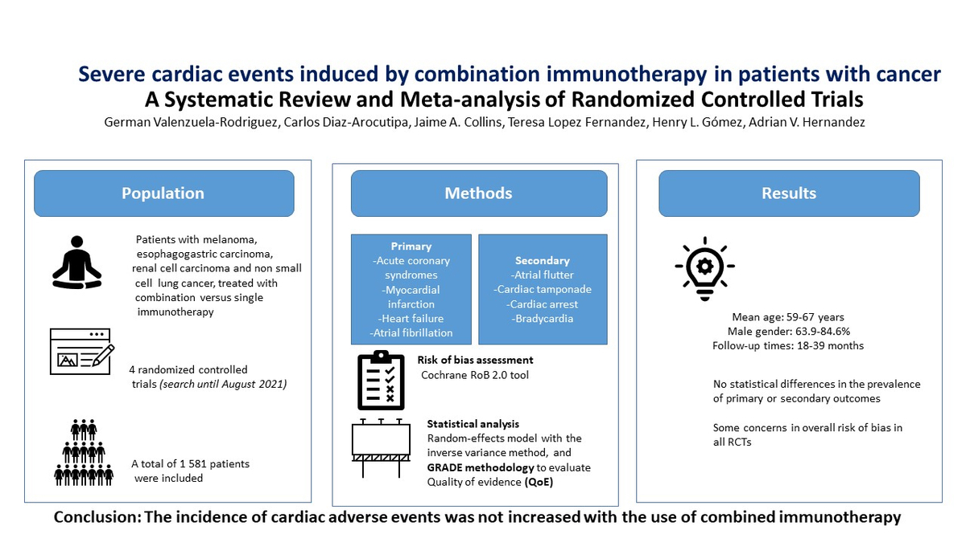

Severe cardiac events induced by combination immunotherapy in patients with cancer: a meta-analysis
DOI: 10.5114/aoms/168124
Arch Med Sci 2023;19(6):1662-1670
Notes:
Introduction
The use of combined immunotherapy could increase non-severe and severe cardiac events in patients with cancer. To examine the occurrence of severe cardiac adverse events of combined immunotherapy compared to single immunotherapy, we analysed 4 electronic databases from inception to August 2021.
Material and methods
We selected randomized controlled trials (RCTs) comparing combined versus single immunotherapy, for the treatment of melanoma, oesophagogastric cancer, renal cell carcinoma, and non-small cell lung cancer. Pre-defined combined immunotherapy included monoclonal antibodies against programmed cell death 1 (PD-1 inhibitors) plus against cytotoxic T lymphocyte antigen 4 (CTLA-4 inhibitors) or against programmed cell death ligand 1 (PD-L1 inhibitors) plus CTLA-4 inhibitors. The pooled risk ratios (RR) with their 95% confidence intervals (CI) were estimated using a random-effects model.
Results
Four RCTs involving 1581 patients were included, with a follow-up time between 18 and 39 months. The use of combined immunotherapy in comparison with single immunotherapy was not associated with an increased risk of severe cardiac adverse events: acute coronary syndromes (RR = 1.76, 95% CI: 0.29–10.83, very low certainty of evidence (CoE)), myocardial infarction (RR = 3.93, 95% CI: 0.44–35.39, very low CoE), heart failure (RR = 2.99, 95% CI: 0.61–14.79, very low CoE), and atrial fibrillation (RR = 2.26, 95% CI: 0.62–8.16, very low CoE).
Conclusions
Our meta-analysis shows that the risk of severe cardiac adverse events with combined immunotherapy seems similar to single immunotherapy, but the evidence is very uncertain. Therefore, more RCTs with longer follow-ups and adequately powered to assess cardiac adverse events are needed to confirm these findings.

