Slide 1
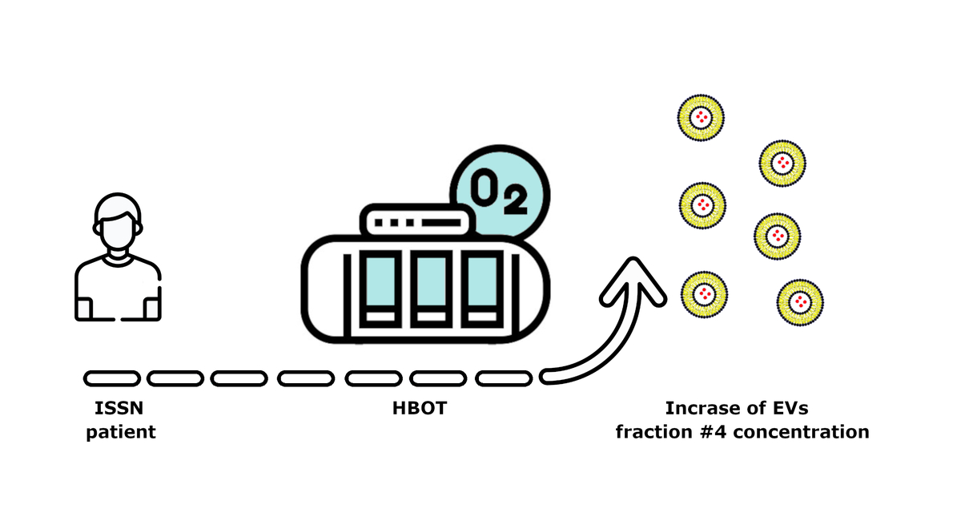

Levels of small extracellular vesicles in patients treated with hyperbaric oxygenation
DOI: 10.5114/aoms/169382
Arch Med Sci 2024;20(2):476-484
Notes:
Introduction
Hyperbaric oxygen (HBO<sub>2</sub><sub></sub>) therapy involves the inhalation of pure oxygen in a pressure chamber under increased ambient pressure. Recent research indicates that circulating small extracellular vesicles (sEVs) play important roles in human physiology and pathology. Therefore, the objective of this pilot study was to monitor the impact of HBO<sub>2</sub> therapy on the levels of circulating sEVs in the serum of patients with necrotizing soft-tissue infections (NSTI), aseptic bone necrosis (ABN) or idiopathic sudden sensory neural hearing loss (ISSNHL).
Material and methods
Serum-derived sEVs were isolated and quantified in 80 patients before and after HBO<sub>2</sub> therapy applied for NSTI, ISSNHL and ABN patients as well as in normal controls who received neither HBO<sub>2</sub><sub></sub> therapy nor steroids.
Results
We observed a significant increase of circulating sEVs in patients with ISSNHL after HBO2 therapy (p < 0.05), as well as significantly elevated levels of sEVs after HBO<sub>2</sub> therapy compared to patients with NSTI (p < 0.05) and ABN (p < 0.01).
Conclusions
The increase in the levels of sEVs in ISSNHL may be evidence for both the intended reduction of inflammation as a result of steroid therapy and the inhibitory effect of oxidative stress induced by HBO<sub>2</sub> therapy. Thus, sEVs released during HBO<sub>2</sub> therapy might play an important biological role in mediating the response to therapy and might be a promising approach to gain further insights into the therapeutic efficacy of HBO<sub>2</sub> therapy.

