Slide 1
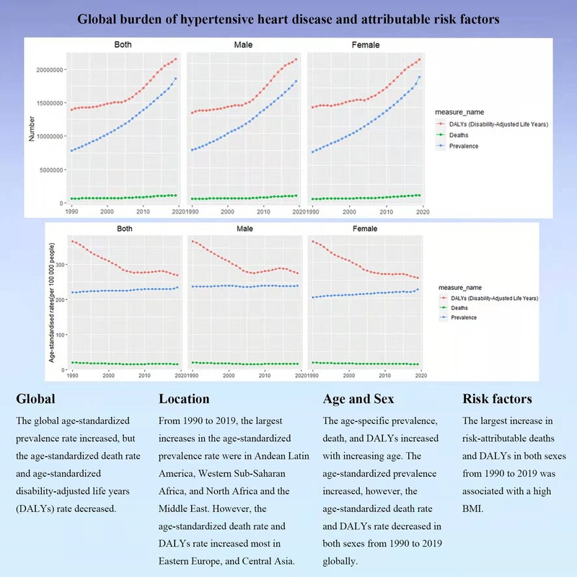

The prevalence, disability-adjusted life years, and mortality of hypertensive heart disease and its attributable risk factors: results from the Global Burden Disease study 2019
DOI: 10.5114/aoms/169477
Arch Med Sci 2023;19(5):1186-1200
Notes:
Introduction
No survey has evaluated hypertensive heart disease (HHD) burden with statistics from the Risk Factors Study, Injuries, and the Global Burden of Diseases (GBD) 2019.
Material and methods
The evaluated annual percentage changes (EAPCs) were obtained to assess the trend in prevalence standardized by age, mortality rates standardized by age, and DALYs standardized by age between 1990 and 2019. We also evaluated the contribution of risk factors to HHD-associated DALYs and mortality.
Results
Between 1990 and 2019, the worldwide prevalence rate standardized by age increased (EAPC = 0.17; 95% confidence interval (CI) 0.15 to 0.18), but the death rate standardized by age (EAPC = –0.74; 95% CI: –0.91 to –0.57) and DALYs standardized by age rate decreased (EAPC = –1.02; 95% CI: –1.18 to –0.86). The prevalence rate of HHD standardized by age increased the most in the high-middle areas of SDI (EAPC = 0.43). The biggest increases in the prevalence rate standardized by age were in Andean Latin America (EAPC = 0.43), Western Sub-Saharan Africa (EAPC = 0.30), and the Middle East and North Africa (EAPC = 0.24). The largest decrease in mortality that could be attributed to rate and DALYs in both sexes between 1990 and 2019 was consistent with a high BMI.
Conclusions
The worldwide prevalence rate standardized by age increased during 1990-2019, especially in Andean Latin America, North Africa, the Middle East, and Western Sub-Saharan Africa. Future HHD prevention tactics should be focused on males, high-risk areas, and control of high BMI.

