Slide 1
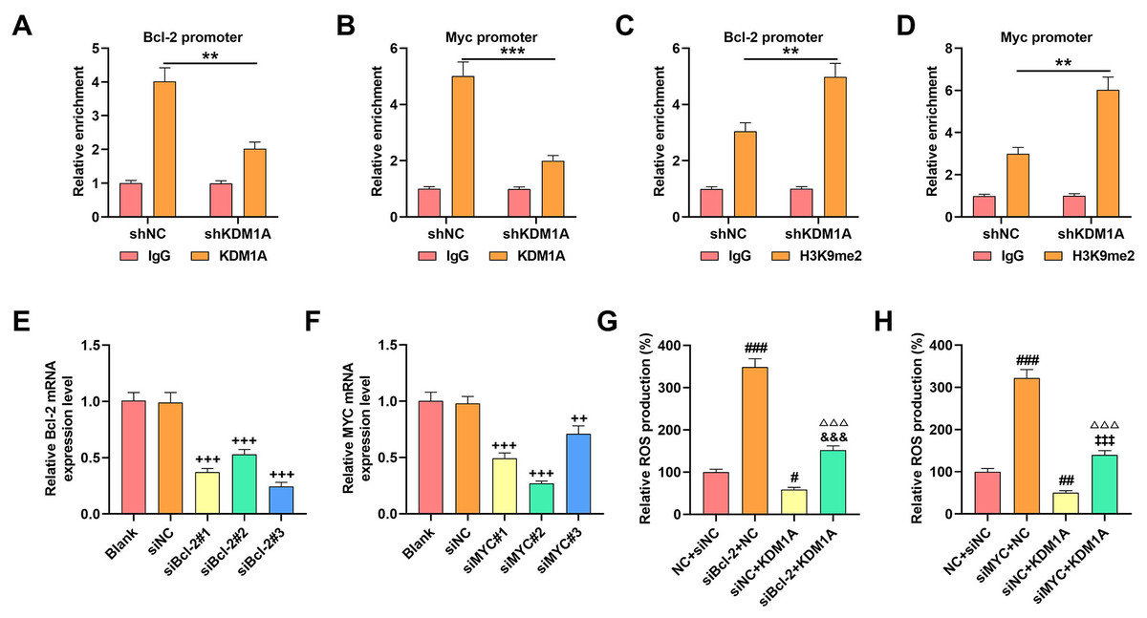

KDM1A represses apoptosis in osteosarcoma cells via demethylating Bcl-2/c-Myc
DOI: 10.5114/aoms/169890
Notes:
Introduction
Considering the poorly understood role of lysine demethylase 1A (KDM1A) in osteosarcoma (OS), we conducted this study to elucidate the underlying mechanism.
Material and methods
Following the appropriate transfection, 3-[4,5-dimethylthiazol-2-yl]-2,5 diphenyl tetrazolium bromide (MTT) and flow cytometry assays were used to determine the viability and apoptosis of MG-63 OS cells, in which the generation of reactive oxygen species (ROS) and the binding between KDM1A and Bcl-2/ cellular Myc (c-Myc) were separately confirmed via the DCF-DA (2,7-dichlorodihydrofluorescein diacetate) method and chromatin immunoprecipitation-PCR. Reverse-transcription quantitative PCR and western blot were finally introduced to quantify the levels of KDM1A/Bcl-2/c-Myc and endoplasmic reticulum (ER) stress-related factors.
Results
Overexpressed KDM1A enhanced the viability (48 h) yet repressed the apoptosis and ROS generation, with downregulation of ER stress-related factors (C/EBP homologous protein [CHOP]; proline-rich extensin-like receptor kinase (PERK) and activating transcription factor 4 [ATF4]) but elevation of Bcl-2/c-Myc, while its depletion exerted contrary effects. More importantly, KDM1A could act as the demethylase of Bcl-2/c-Myc, as reflected by the results showing that the depletion of KDM1A decreased the enrichment of Bcl-2/c-Myc promoter using the antibody against KDM1A yet increased the enrichment by the antibody targeting H3K9me2. Bcl-2/c-Myc silencing, conversely, promoted ROS generation and apoptosis, elevated the levels of ER stress-related factors and abolished the effects of KDM1A on OS cells.
Conclusions
KDM1A exerts a repressive effect on the apoptosis of MG-63 OS cells by inhibiting ROS generation and ER stress via demethylation of Bcl-2 and c-Myc.

