Slide 1
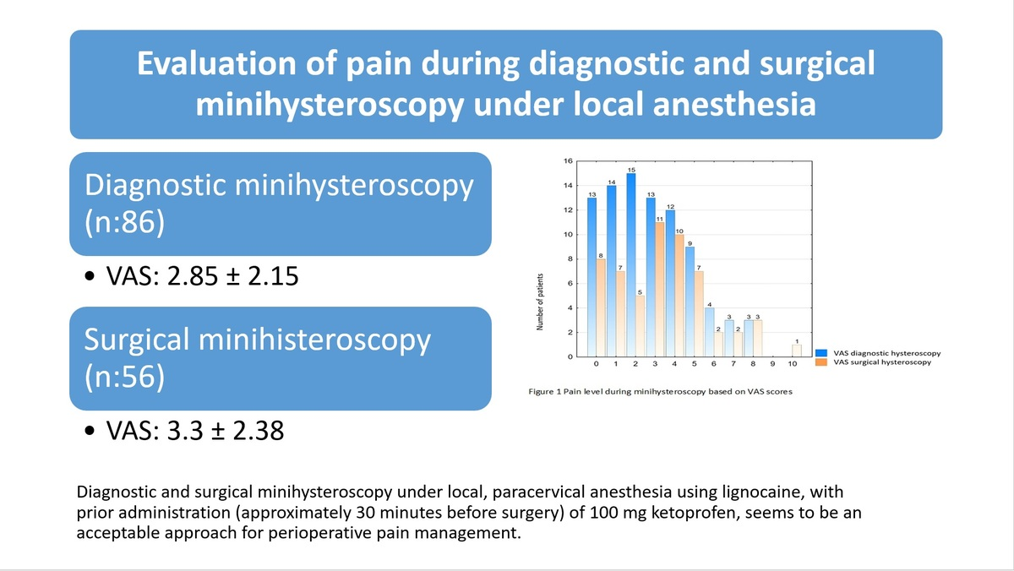

Evaluation of pain during diagnostic and surgical minihysteroscopy under local anesthesia
DOI: 10.5114/aoms/169979
Arch Med Sci 2025;21(2):463-470
Notes:
Introduction
Hysteroscopy is currently considered the gold standard for the diagnosis and treatment of lesions in the uterine cavity and cervical canal. Currently, smaller diameter hysteroscopes are used, which enable the procedure to be performed without general anesthesia. Despite the use of smaller operating tools, some patients report pain.
Material and methods
The study included 142 patients who were divided into two groups: diagnostic hysteroscopy (86) and surgical hysteroscopy (56). Before the start of the procedure, ketoprofen intravenously and lignocaine paracervically were administered to the patient. The level of pain was measured using the visual analog scale (VAS).
Results
The average intensity of pain during the procedure in both groups was rated at 3 points (3.03 ±2.25 points). There was no statistically significant difference between the two groups (VAS score 2.85 ±2.15 vs. 3.3 ±2.38). However, it was noted that as the duration of the procedure increased (regardless of the type), the level of pain experienced increased.
Conclusions
Minihysteroscopy under local, paracervical anesthesia using lignocaine, with prior administration (approximately 30 min before surgery) of 100 mg ketoprofen, seems to be an optimal approach for perioperative pain management. The results of the study suggest that hysteroscopes with a smaller diameter and paracervical block can be successfully used in outpatient medical practice.

