Slide 1
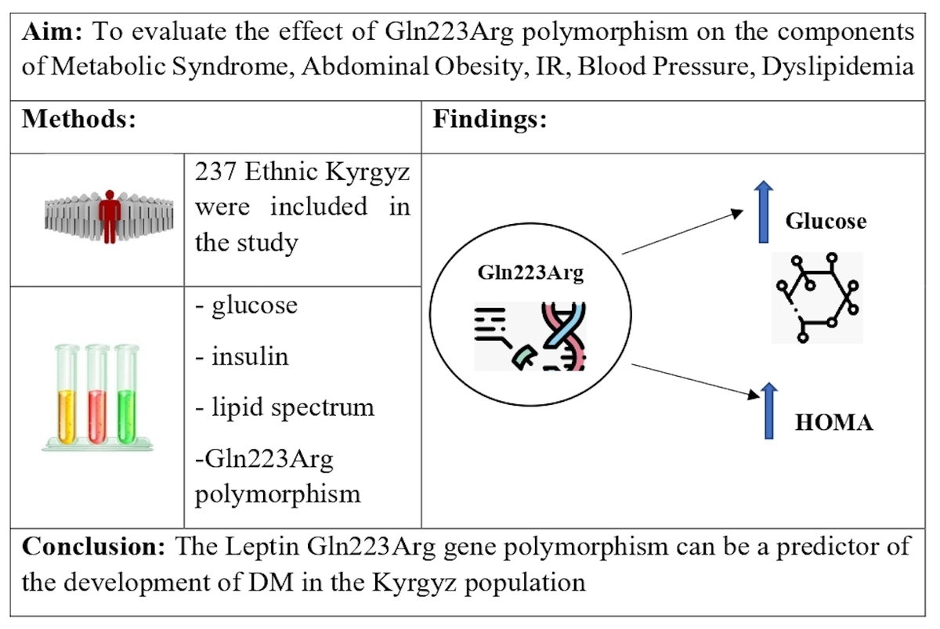

Association of leptin receptor gene Gln223Arg polymorphism with insulin resistance and hyperglycemia in patients with metabolic syndrome
DOI: 10.5114/aoms/170121
Arch Med Sci 2024;20(1):54-60
Notes:
Introduction
Worldwide, there has been an increase in the incidence of metabolic syndrome. The search for genetic markers of this syndrome is ongoing. The leptin receptor has recently received attention. One of the polymorphisms (Gln223Arg) is possibly associated with the development of obesity and insulin resistance. However, the results of studies on this polymorphism remain equivocal. Gln223Arg polymorphism has not been studied previously in the Kyrgyz population. Thus, we aimed to investigate the possible association of the Gln223Arg polymorphism of the leptin receptor gene with metabolic syndrome components in the Kyrgyz population.
Material and methods
237 Kyrgyz subjects, aged 35–70 years, were studied. For the analysis anthropometric data, glucose, insulin, lipid spectrum, leptin were obtained. The genotype of the Gln223Arg leptin polymorphism was evaluated using TaqMan real-time PCR.
Results
The distribution of genotypes was as follows: Gln223Gln 46.4%, Gln223Arg 40.1%, Arg223Arg 13.5%. In the study no association was found with abdominal obesity, arterial hypertension, hypertriglyceridemia or low-density cholesterol levels. Relationships of Gln223Arg and Arg223Arg genotypes with insulin resistance (p < 0.03) were found. Gln223Arg polymorphism was associated with a higher level of glycemia (5.54 vs. 5.39 mmol/l, p < 0.05) and insulinemia (8.3 vs. 7.1 µIU/ml, p < 0.05). Correlation analysis showed that carriers of the Arg223 allele demonstrated a higher risk of insulin resistance (odds ratio (OR) = 1.83, 95% CI: 1.03–3.24; p < 0.03) than carriers of the Gln223 allele.
Conclusions
Gln223Arg polymorphism of the leptin receptor gene may be a marker of predisposition to insulin resistance in the Kyrgyz population. Further studies are necessary to confirm these results in populations from other regions.

