Slide 1
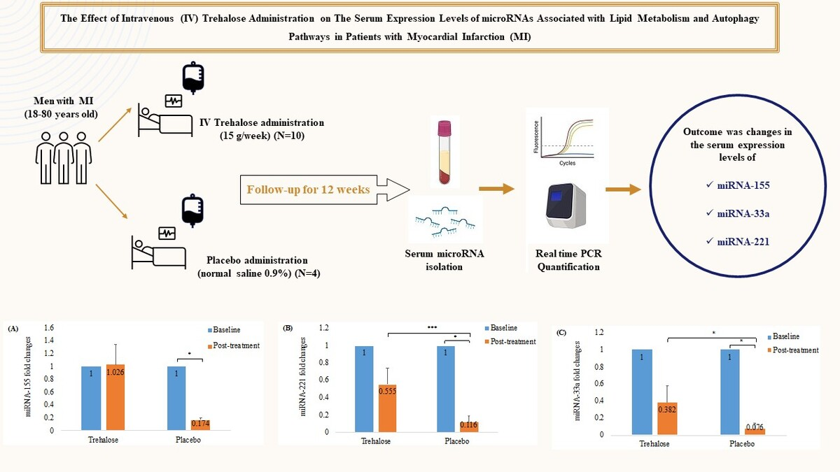

The effect of trehalose administration on the serum expression levels of microRNAs associated with lipid metabolism and the autophagy process in patients with myocardial infarction – post-hoc analysis of the IR-TREAT trial
DOI: 10.5114/aoms/170159
Notes:
Introduction
This study aimed to evaluate the trehalose (TRE)-induced changes in the serum expression levels of microRNAs (miRNAs) associated with lipid metabolism and the autophagy process in myocardial infarction (MI) patients to assess the potential protective effects of TRE in these patients.
Material and methods
This post hoc investigation was performed on serum samples obtained from a pilot randomized, double-blind, placebo-controlled clinical trial (IR-TREAT) that recruited 14 men (aged 18–80 years) with MI and systemic inflammation. The patients were randomized in a 2 : 1 ratio to either TRE (15 g/week, intravenous (IV) administration) (n = 10) or placebo groups (equal volume of saline 0.9%) (n = 4) for a period of 12 weeks. To measure the relative serum expression levels of miRNA-155 (macrophage function regulator), miRNA-221 (autophagy regulator), and miRNA33a (regulator of macrophage autophagy and cholesterol efflux pathway), the SYBR Green quantitative polymerase chain reaction (qPCR) method was used.
Results
miRNA-155 showed significantly higher serum expression levels in the TRE group (2.772 ±0.73; p = 0.009) when compared to the placebo group. Also, significant reductions in miRNA-155 (0.171 ±0.03; p = 0.016), miRNA-221 (0.116 ±0.07; p = 0.013), and miRNA-33a (0.076 ±0.07; p = 0.025) were observed in the placebo group at the end of the study. Nevertheless, the reduction (normalized to the baseline) of the serum expression levels of miRNA-221 (fold change (FC): 0.87 ±0.20 vs. FC: 0.18 ±0.08; p = 0.009) and miRNA-33a (FC: 0.73 ±0.22 vs. FC: 0.13 ±0.08; p = 0.025) were significantly lower in TRE group than in the placebo group.
Conclusions
Intravenous trehalose administration did not reduce the expression of miRNA-221 and miRNA-33a as much as placebo. Keeping a steady state of the serum expression levels of these miRNAs associated with lipoproteins metabolism and autophagy in the TRE group might have protective effects in patients with MI.

