Slide 1
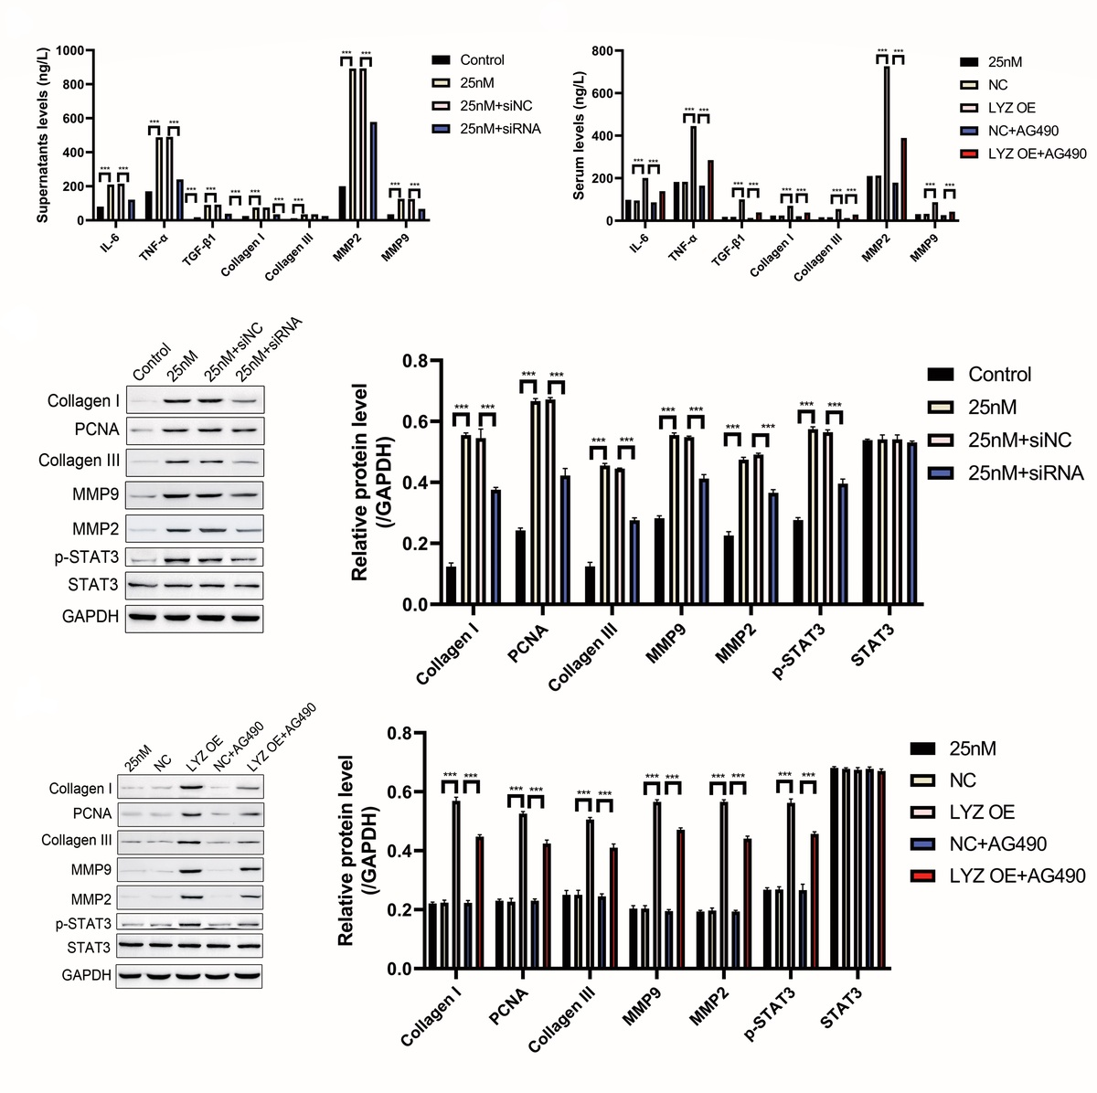

Lysozyme promotes renal fibrosis through the JAK/STAT3 signal pathway in diabetic nephropathy
DOI: 10.5114/aoms/170160
Arch Med Sci 2024;20(1):233-247
Notes:
Introduction
Diabetic nephropathy (DN) is a leading cause of kidney failure. Lysozyme (LYZ) is an essential component of innate immunity and exhibits antibacterial properties. However, LYZ has been reported to induce nephropathy, implying a possible association between impaired renal function and lysozyme expression.
Material and methods
Bioinformatics analysis was used to predict the hub gene associated with DN, and the differential expression of the hub gene was confirmed using a mouse model. A mouse model of streptozotocin (STZ)-induced diabetic nephropathy was established to investigate the correlation between DN and LYZ expression, and the functionality of LYZ was verified through knockdown and overexpression experiments conducted in vivo. Immunohistochemistry (IHC) was utilized to assess fibrosis-related markers and cytokines, while Masson staining was performed to assess renal fibrosis. Fibroblast proliferation was assessed using the Cell Counting Kit-8 (CCK-8) assay. The role of the JAK pathway was confirmed using the JAK inhibitor AG490, and Western blot was used to investigate the underlying mechanisms.
Results
Mechanistically, 25 mM glucose promotes the expression of LYZ in fibroblastic cells, and LYZ may in turn promote the proliferation of renal interstitial fibroblasts. Western blot shows that glucose can activate STAT3 in an LYZ-dependent manner, and the JAK inhibitor AG490 can partially suppress LYZ-induced STAT3 activation. Furthermore, in vivo observations have revealed that overexpression of LYZ is associated with the senescent phenotype of renal tubular epithelial cells (RTECs).
Conclusions
Lysozyme promotes kidney fibrosis via the JAK/STAT3 signaling pathway in diabetic nephropathy, and glucose may promote fibroblast proliferation by promoting LYZ auto-secretion.

