Slide 1
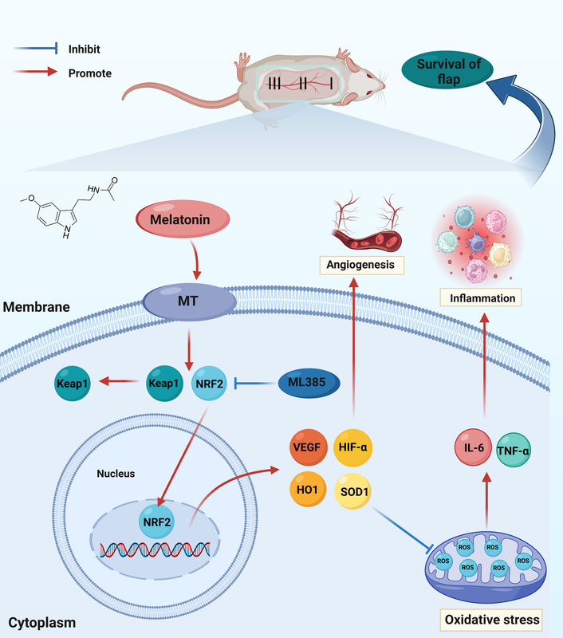

Melatonin enhances the viability of random-pattern skin flaps by activating the NRF2 pathway
DOI: 10.5114/aoms/170172
Arch Med Sci 2025;21(5):2144-2163
Notes:
Introduction
Random skin flap transplantation has been widely used in reconstructive and plastic surgery. As a well-known antioxidant, melatonin has the functions of eliminating reactive oxygen species (ROS), promoting angiogenesis, and protecting against ischemia-reperfusion injury (IRI). We explored the effects of melatonin on random skin flap survival and the potential molecular mechanisms.
Material and methods
A total of 72 rats were randomly assigned to the control group, the melatonin (MEL) group, and MEL + ML385 groups. After construction of the random skin flap model, these groups were treated with physiological saline, melatonin, and melatonin + ML385, respectively. The general conditions of random skin flaps were observed daily after the procedure. Laser doppler blood flow (LDBF) imaging was used to evaluate the subcutaneous vascular network. On postoperative day 7, the animals were euthanized to obtain random skin flap specimens. Hematoxylin-eosin (HE) staining was used to evaluate the vessel density. Immunohistochemistry, immunofluorescence staining, and western blotting were used to evaluate the expression of proteins involved in angiogenesis, oxidative stress, and inflammation.
Results
Compared to the control group, the MEL group exhibited lower tissue water content, a more abundant vascular network, and higher vascular density, thereby enhancing the survival of random skin flaps. Additionally, the MEL group showed increased expression of angiogenesis-related proteins, enhanced expression of antioxidant proteins, and decreased expression of inflammatory factors. Furthermore, ML385, a specific nuclear factor erythroid-2-related factor 2 (NRF2) inhibitor, reversed the beneficial effect of melatonin on random skin flaps.
Conclusions
The findings of our present study demonstrated that melatonin promotes angiogenesis and inhibits oxidative stress and inflammation by activating the NRF2 signaling pathway, thus improving the survival of random skin flaps.

