Slide 1
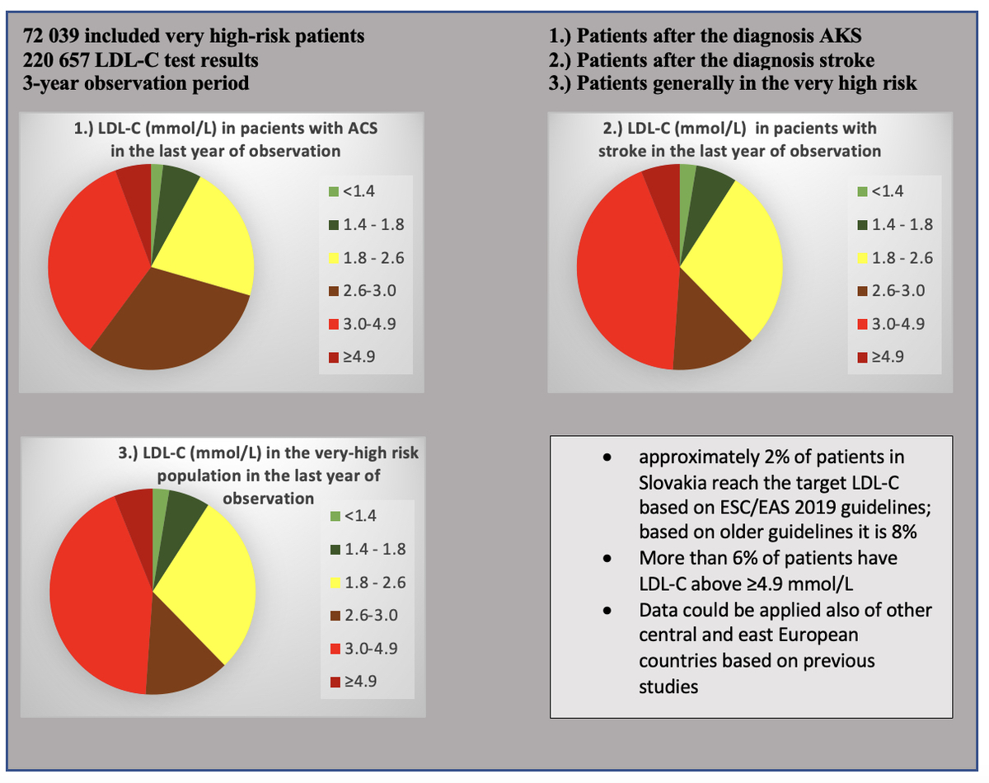

Success in achieving LDL-C target values in a high-risk population in Slovakia: the SlovakLipid retrospective study
DOI: 10.5114/aoms/170961
Arch Med Sci 2025;21(3):738-746
Notes:
Introduction
Slovakia is among the countries with the highest cardiovascular mortality; nevertheless, extensive data on the effectiveness of dyslipidaemia management are lacking. The aim of this study was to assess the implementation of European guidelines in the very high-risk population in Slovakia.
Material and methods
We retrospectively analysed anonymised low-density lipoprotein-cholesterol (LDL-C) values of patients at very high cardiovascular risk gathered between 2017 and 2019 from a collaborating laboratory with nationwide reach. Cardiovascular risk (CV) risk was based on the patient’s International Classification of Diseases (ICD) diagnosis. LDL-C target values were based on the 2016 ESC/EAS recommendations, as well as current recommendations from 2019. Patients diagnosed with acute coronary syndrome (ACS), stroke, or overall very high-risk cardiovascular disease (CVD) were selected.
Results
A total of 220 657 LDL-C test results from 72 039 patients were processed. Only 8–9% of patients with ACS attained target LDL-C in a follow-up test each year. 6–9% of patients had LDL-C levels ≥ 4.9 mmol/l. Only 9–10% of patients with stroke achieved target LDL-C levels, and 7–8% had levels ≥ 4.9 mmol/l. In the very high CV risk group, only 7% of patients achieved target levels, and 7–8% had extremely high LDL-C levels ≥ 4.9 mmol/l. With the ESC/EAS 2019 recommendations only 2–3% of patients in each group achieved target levels each year.
Conclusions
Based on our results, we found that over 90% of patients with very high CVD risk do not achieve target LDL-C levels. This percentage is even higher when implementing the 2019 guidelines. These patients remain at high risk of subsequent CVD events and would benefit significantly from intensified hypolipaemic therapy.

