Slide 1
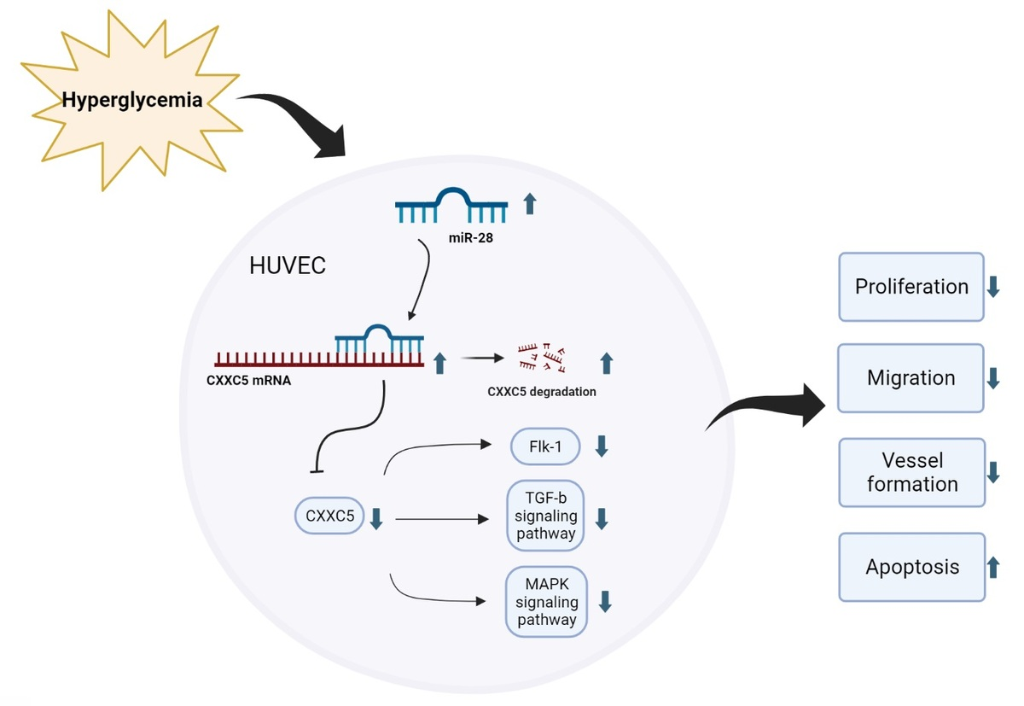

MiR-28-3p regulates high glucose-induced endothelial dysfunction by targeting CXXC5
DOI: 10.5114/aoms/171024
Arch Med Sci 2025;21(3):930-943
Notes:
Introduction
Data from the CEO database show that microRNA (miR)-28-3p levels are elevated in diabetic patients. Nevertheless, the role of miR-28-3p in peripheral artery disease with diabetes has not been investigated.
Material and methods
The levels of miR-28-3p, CXXC5, CXXC-type zinc finger protein 5, and CXXC5’s downstream molecules as well as endothelial function were investigated. Dual luciferase analyses were used to confirm the binding site of miR-28-3p and CXXC5.
Results
Under high-glucose conditions, miR-28-3p expression is upregulated, whereas CXXC5 expression is downregulated. Overexpression of miR-28-3p increased cell apoptosis and inhibited cell proliferation, migration, and vessel formation, whilst inhibiting its expression had the opposite effect. The overexpression and inhibition of miR-28-3p could also influence both the mRNA and protein levels of CXXC5 and its known downstream molecules. Analysis of bioinformatics data revealed a potential binding site for miR-28-3p and CXXC5. Dual luciferase analyses demonstrated that miR-28-3p suppressed CXXC5 expression by targeting the 3-untranslated region (3-UTR) of CXXC5. Following that, we overexpressed both miR-28-3p and CXXC5. The level of CXXC5 and its known downstream signaling molecules decreased with miR-28-3p overexpression alone. As anticipated, co-overexpression of miR-28-3p and CXXC5 partially reversed the effect of miR-28-3p mimics.
Conclusions
These findings indicated that miR-28-3p regulated high glucose-induced endothelial dysfunction by targeting CXXC5.

