Slide 1
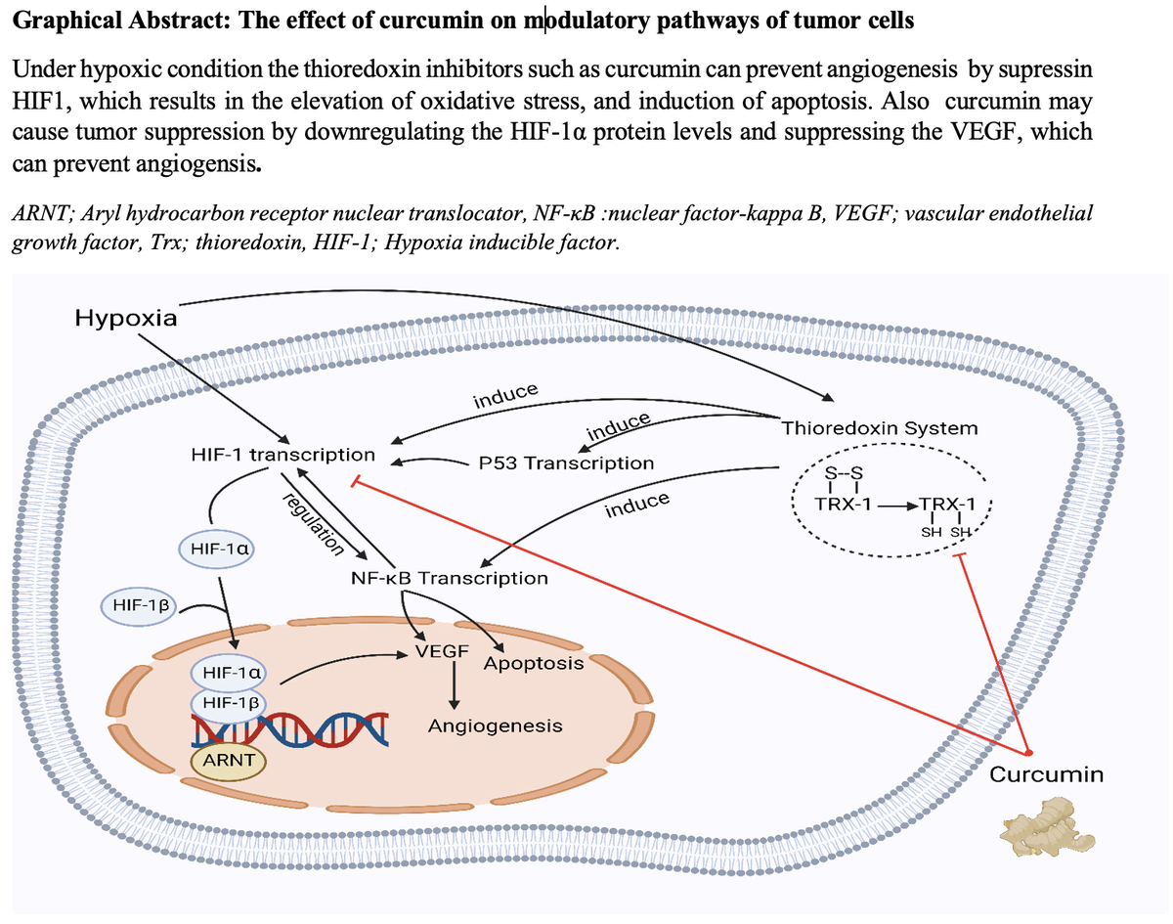

The effect of curcumin on hypoxia in the tumour microenvironment as a regulatory factor in cancer
DOI: 10.5114/aoms/171122
Arch Med Sci 2023;19(6):1616-1629
Notes:
Hypoxia can lead to different responses from cancer cells, including cell death or survival, partially depending on how long it is exposed. Patients with cancer and under hypoxic tumour conditions have a poorer prognosis and are at greater risk of metastasis. Physiological response to low oxygen levels is controlled by hypoxia-inducible factor (HIF)-1. Curcumin, the major component of the rhizomes of Curcuma longa L., reduces HIF-1 levels and function, inhibiting the production of vascular endothelial growth factor (VEGF). In addition, curcumin efficiently inhibits the angiogenesis of vascular endothelial cells triggered by hypoxia. One of the most compelling features that drive continued interest in curcumin is the molecules’ modulation of initiation, promotion, and progression stages of cancer while concomitantly acting as a radiosensitizer and chemosensitizer for tumours. In this review, we discuss the role of curcumin in modulating hypoxia and investigate the mechanisms and regulatory factors of hypoxia in tumour tissues.

