Slide 1
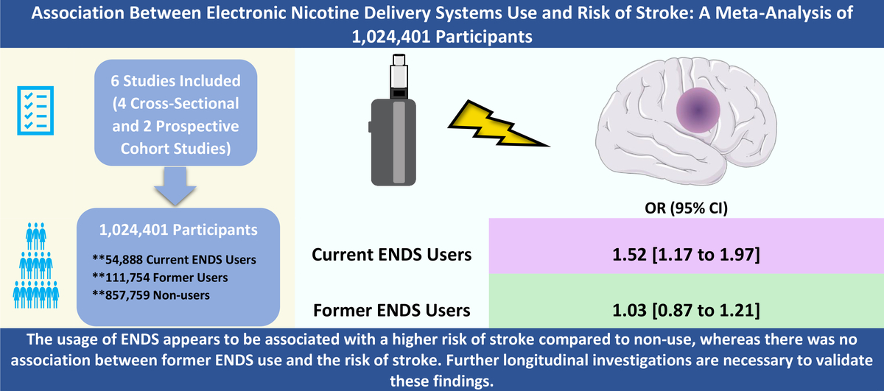

Association between electronic nicotine delivery systems use and risk of stroke: a meta-analysis of 1,024,401 participants
DOI: 10.5114/aoms/171473
Arch Med Sci 2023;19(5):1538-1540
Notes:
Introduction
To evaluate the relationship between electronic nicotine delivery systems (ENDS) use and the risk of stroke when compared to non-smokers.
Material and methods
A comprehensive search was conducted until June 15, 2023. We included observational studies that assessed association of current or former usage of ENDS with risk of stroke compared with non-smokers, reported the risk estimate as odds ratio (OR) or hazard ratio (HR) and were adjusted for possible confounders.
Results
6 studies with 1,024,401 participants were included in our analysis. ENDS use was associated with a significant increased risk of stroke (OR = 1.52; 95% CI: 1.17–1.97) compared with non-users. A non-significant association was found between former ENDS use and risk of stroke (OR = 1.03; 95% CI: 0.87–1.21).
Conclusions
The ENDS usage appears to be associated with a higher risk of stroke compared to non-use, whereas there was no association between former ENDS use and the risk of stroke.

