Slide 1
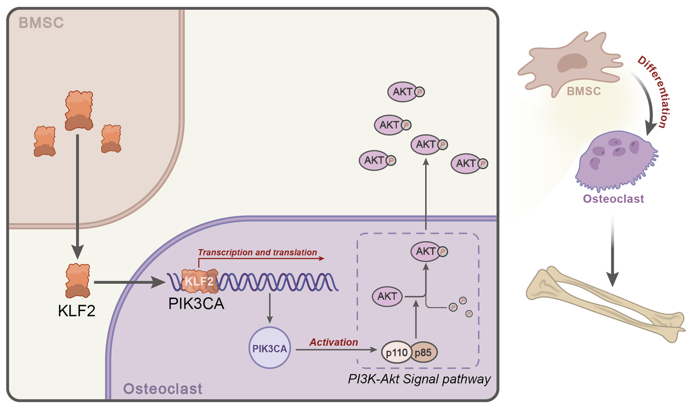

Enhancing postmenopausal osteoporosis: a study of KLF2 transcription factor secretion and PI3K-Akt signaling pathway activation by PIK3CA in bone marrow mesenchymal stem cells
DOI: 10.5114/aoms/171785
Arch Med Sci 2024;20(3):918-937
Notes:
Introduction
Mesenchymal stem cells can develop into osteoblasts, making them a promising cell-based osteoporosis treatment. Despite their therapeutic potential, their molecular processes are little known. Bioinformatics and experimental analysis were used to determine the molecular processes of bone marrow mesenchymal stem cell (BMSC) therapy for postmenopausal osteoporosis (PMO).
Material and methods
We used weighted gene co-expression network analysis (WGCNA) to isolate core gene sets from two GEO microarray datasets (GSE7158 and GSE56815). GeneCards found PMO-related genes. GO, KEGG, Lasso regression, and ROC curve analysis refined our candidate genes. Using the GSE105145 dataset, we evaluated KLF2 expression in BMSCs and examined the link between KLF2 and PIK3CA using Pearson correlation analysis. We created a protein-protein interaction network of essential genes involved in osteoblast differentiation and validated the functional roles of KLF2 and PIK3CA in BMSC osteoblast differentiation in vitro.
Results
We created 6 co-expression modules from 10 419 differentially expressed genes (DEGs). PIK3CA, the key gene in the PI3K-Akt pathway, was among 197 PMO-associated DEGs. KLF2 also induced PIK3CA transcription in PMO. BMSCs also expressed elevated KLF2. BMSC osteoblast differentiation involved the PI3K-Akt pathway. In vitro, KLF2 increased PIK3CA transcription and activated the PI3K-Akt pathway to differentiate BMSCs into osteoblasts.
Conclusions
BMSCs release KLF2, which stimulates the PIK3CA-dependent PI3K-Akt pathway to treat PMO. Our findings illuminates the involvement of KLF2 and the PI3K-Akt pathway in BMSC osteoblast development, which may lead to better PMO treatments.

