Slide 1
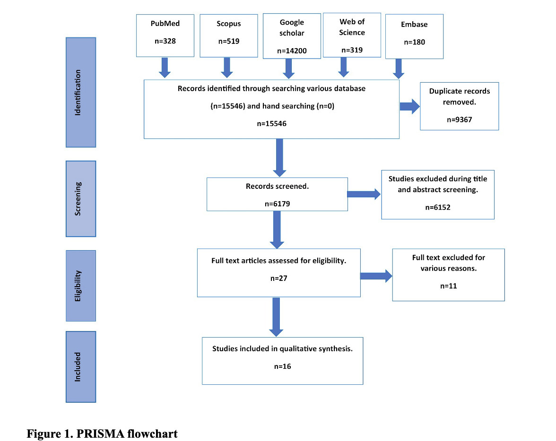

Association of stress, anxiety and depression with temporomandibular disorders in young adults – a systematic review
DOI: 10.5114/aoms/171955
Notes:
Introduction
The current systematic review aims to explore whether there is an association between temporomandibular disorder (TMD) and psychological factors such as stress, anxiety, and/or depression in young adults.
Material and methods
A systematic search was conducted on 14 March 2023 for publications from inception until February 2023, according to the PRISMA guidelines, using five major databases: the Cochrane Database of Systematic Reviews, PubMed, EMBASE, Web of Science, SCOPUS, and Google Scholar. The PECO framework formulated the focused question “Is there an association between TMD and psychological factors (stress/depression/anxiety) among young adults?” The study was previously registered with trial no. CRD42023407502. Articles were selected according to the inclusion criteria. For each study, risk of bias was applied to assess the quality of the included article using the Newcastle-Ottawa scoring system. The level of evidence was determined using GRADE (Grading of Recommendations, Assessment, Development, and Evaluations) scoring.
Results
Sixteen studies were included for final qualitative synthesis and the certainty of evidence assessment out of the 15 546 studies identified initially from different databases, with the total of 6362 participants. The included studies confirmed the association between different types of TMD and psychological factors in young adults. The risk of bias among the included studies was low, and the GRADE evidence reported was very low among included studies.
Conclusions
Within the scope of this systematic review, it could be concluded that there is an association between temporomandibular disorder and psychological factors. Painful TMD in young females was associated with anxiety and stress.

