Slide 1
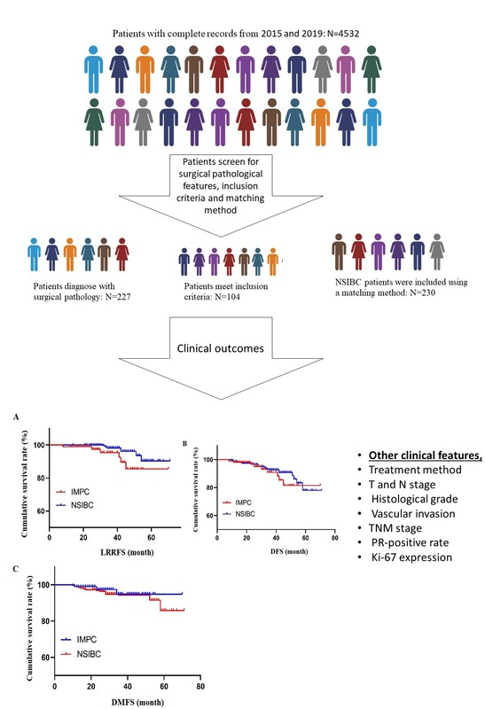

Clinicopathological characteristics and prognostic factors in invasive micropapillary carcinoma of the breast
DOI: 10.5114/aoms/173213
Arch Med Sci 2024;20(2):428-435
Notes:
Introduction
Invasive micropapillary carcinoma (IMPC) treatment only relies on the standard treatment of nonspecific invasive breast cancer (NSIBC), and it remains controversial whether the survival of patients improves. Therefore, this study aimed to analyze the clinicopathological features of IMPC and to investigate the factors affecting its prognosis.
Material and methods
This retrospective cohort study included 104 IMPC patients who met the study’s inclusion criteria out of a total of 4,532 patients with invasive breast cancer between January 2015 and December 2019. A contemporaneous cohort of 230 patients with non-specific invasive breast cancer (NSIBC) who underwent surgery was identified and matched using propensity scores.
Results
The survival rate for patients with IMPC ranged from 1.12% to 7.03%. Statistically significant differences were observed in the proportion of endocrine treatment, lymphatic invasion, estrogen receptor (ER)-positive rate, molecular subtypes, molecular typing, and 5-year loco-regional recurrence-free survival (LRRFS) between the two cohorts (p < 0.05). The univariate analysis showed that T stage, N stage, lymphatic invasion, vascular invasion, ER-positive rate, and progesterone receptor (PR)-negative rate were all prognosis risk factors (p < 0.05) for IMPC. Furthermore, the multivariate analysis indicated that lymphatic invasion and N stage were independent prognostic factors (p < 0.05).
Conclusions
The incidence of micropapillary IMPC, among other pathological subtypes, is steadily increasing. ER-positive and PR-positive rates, as well as luminal subtypes, are frequent, with a concurrent increase in the 5-year locoregional recurrence rate. It would be interesting to compare the effect following these therapeutic modifications in larger cohorts in future studies.

