Slide 1
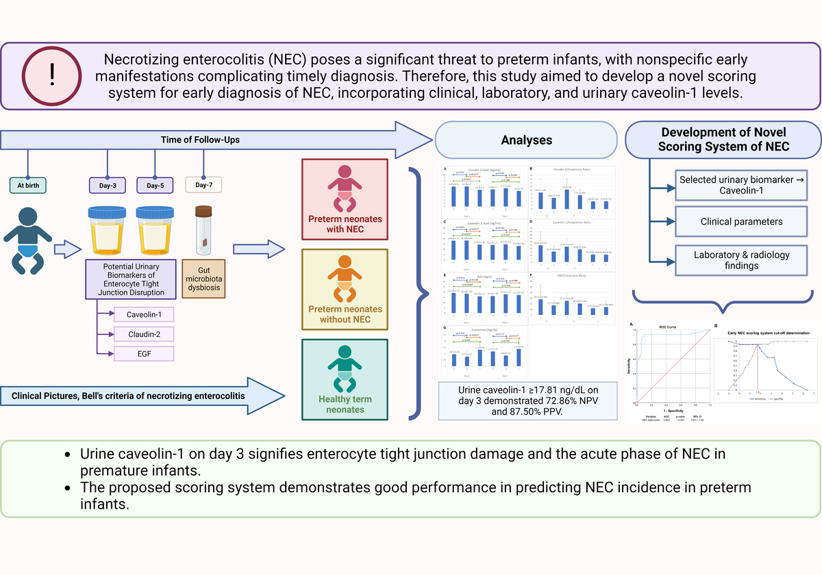

Novel scoring system for early diagnosis of necrotizing enterocolitis: integrating clinical and laboratory data with urinary caveolin-1 levels
DOI: 10.5114/aoms/173390
Arch Med Sci 2024;20(2):444-456
Notes:
Introduction
Necrotizing enterocolitis (NEC) poses a significant threat to preterm infants, with nonspecific early manifestations complicating timely diagnosis. Therefore, this study aimed to develop a novel scoring system for early diagnosis of NEC, incorporating clinical and laboratory data with urinary caveolin-1 levels.
Material and methods
A single-center prospective cohort study was conducted at a tertiary hospital in East Java, Indonesia. NEC diagnosis was established by Bell’s criteria and proven gut dysbiosis. Urinary levels of claudin-2, caveolin-1, and epidermal growth factor (EGF) were assessed as potential indicators of tight junction disruption. The selected urine biomarker cutoff value was determined using symbolic classification analysis and combined with clinical and laboratory parameters from Bell’s criteria to create an NEC scoring system, validated with the Aiken index. Sensitivity and specificity analyses were performed.
Results
Thirty-four neonates, comprising NEC, preterm non-NEC, and term infants, were included. qPCR analysis highlighted elevated Klebsiella, Lactobacillus, Clostridium, and Bacteroides levels in NEC patients, indicating a gut dysbiosis trend. Among 3 biomarkers, caveolin-1 ≥ 17.81 ng/dl on day 3 demonstrated 72.86% negative predictive value and 87.50% positive predictive value. The combined scoring system which comprised abdominal cellulitis, distension, radiology, advanced resuscitation at birth, prematurity or low birthweight, platelet count, sepsis, orogastric retention, metabolic acidosis and caveolin-1 findings exhibited an AUC of 0.922 (95% CI: 0.81–1.00, p < 0.001), with ≥ 1.81 as the cutoff, offering 93% sensitivity and 94% specificity.
Conclusions
Urine caveolin-1 on day 3 signifies enterocyte tight junction damage and the acute phase of NEC in premature infants. The proposed scoring system demonstrates good performance in predicting NEC incidence in preterm infants.

