Slide 1
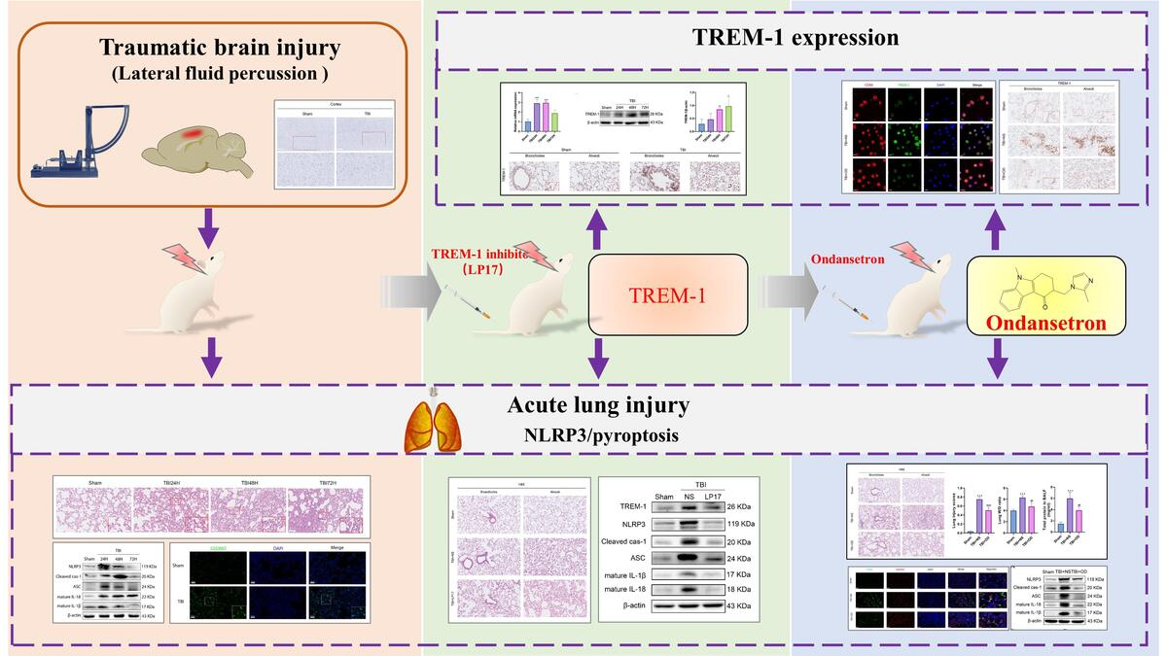

TREM-1 inhibition or ondansetron administration ameliorates NLRP3 inflammasome and pyroptosis
in traumatic brain injury-induced acute lung injury
DOI: 10.5114/aoms/174264
Arch Med Sci 2024;20(3):984-996
Notes:
Introduction
Recently, NLR family pyrin domain containing 3 (NLRP3) and pyroptosis have been reported to be involved in traumatic brain injury-induced acute lung injury (TBI-ALI). Studies have shown that triggering receptor expressed on myeloid cells-1 (TREM-1) may be one of the upstream molecules regulating NLRP3/pyroptosis, and 5-hydroxytryptamine type 3-receptor (5-HT3R) antagonists can inhibit NLRP3/pyroptosis. However, the role of TRME-1 in TBI- ALI, the therapeutic effect of 5-HT3R inhibition on TBI-ALI and its mechanism are still unclear. Therefore, this study aimed to evaluate the protective effect of ondansetron, a 5-HT3 inhibitor, on TBI-ALI, and to explore whether the underlying mechanism is related to the regulation of TREM-1.
Material and methods
A TBI-ALI rat model was constructed via lateral fluid percussion (LFP) brain injury, and either TREM-1 inhibitor (LP17) or ondansetron was administered as needed.
Results
TBI induced NLRP3 inflammasome, pyroptosis, and TREM-1 activation in rat lung tissues in a time-dependent manner. Inhibition of TREM-1 activity attenuated TBI-ALI; this is evident from reduced pathological scores, wet/dry ratios, and bronchoalveolar lavage fluid protein levels and alleviated NLRP3 inflammasome/pyroptosis. In addition, ondansetron reduced NLRP3 inflammasome/pyroptosis and alleviated TBI-ALI. Moreover, ondansetron reduced TREM-1 activation in macrophages and lung tissue.
Conclusions
Ondansetron alleviated TBI-ALI. In terms of mechanism, TREM-1 promotes TBI-ALI via the NLRP3-related pyroptosis pathway, and the protective effect of ondansetron on TBI-ALI may be related to the inhibition of TREM-1.

