Slide 1
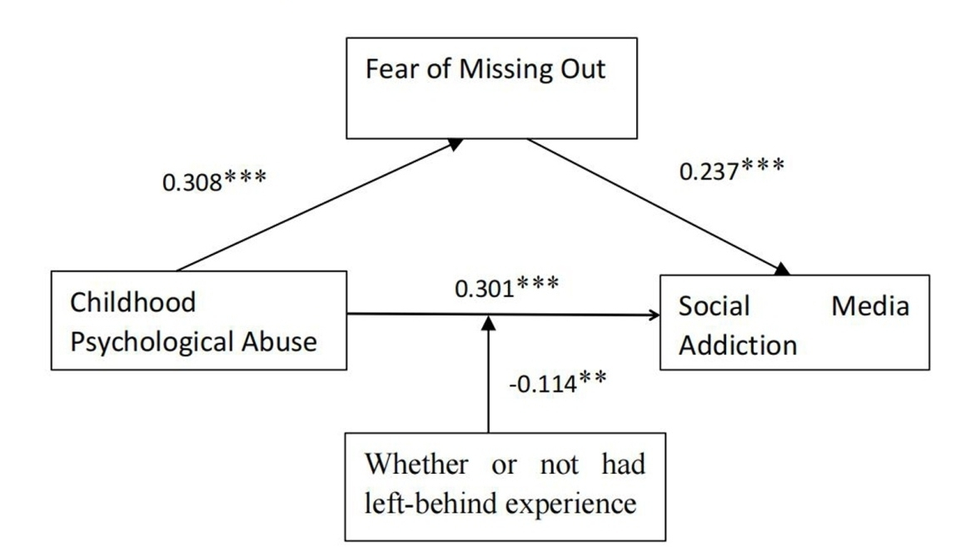

The relationship between childhood psychological abuse and social media addiction among college students: the mediating role of fear of missing out and the moderating role of left-behind experience
DOI: 10.5114/aoms/174649
Arch Med Sci 2024;20(3):798-805
Notes:
Introduction
Mobile social media is a new type of online media that is participatory, open, and communicative, among other characteristics. Due to the increasing popularity of social media, this technology has become an indispensable part of people’s social lives. This study aims to examine the relationship between childhood psychological maltreatment and social media addiction among university students as well as the mediating role of fear of missing out and the moderating effect of left-behind experience in this context.
Material and methods
A voluntary anonymous online survey of 1694 university students was conducted using the Childhood Psychological Maltreatment Scale, the Fear of Missing Out Scale, and the Social Media Addiction Scale.
Results
First, significant positive correlations were observed between childhood psychological maltreatment and both fear of missing out and social media addiction among university students. Fear of missing out partially mediated the relationship between childhood psychological maltreatment and social media addiction. Second, left-behind experience was found to moderate the direct path from childhood psychological maltreatment to social media addiction as well as the first half of the mediating effect of missed anxiety.
Conclusions
Childhood psychological maltreatment can predict social media addiction among university students not only directly but also indirectly through the mediating role of missed anxiety. The direct effect of childhood psychological maltreatment on social media addiction is moderated by left-behind experience. The first half of the mediating role of missed anxiety is also moderated by left-behind experience.

