Slide 1
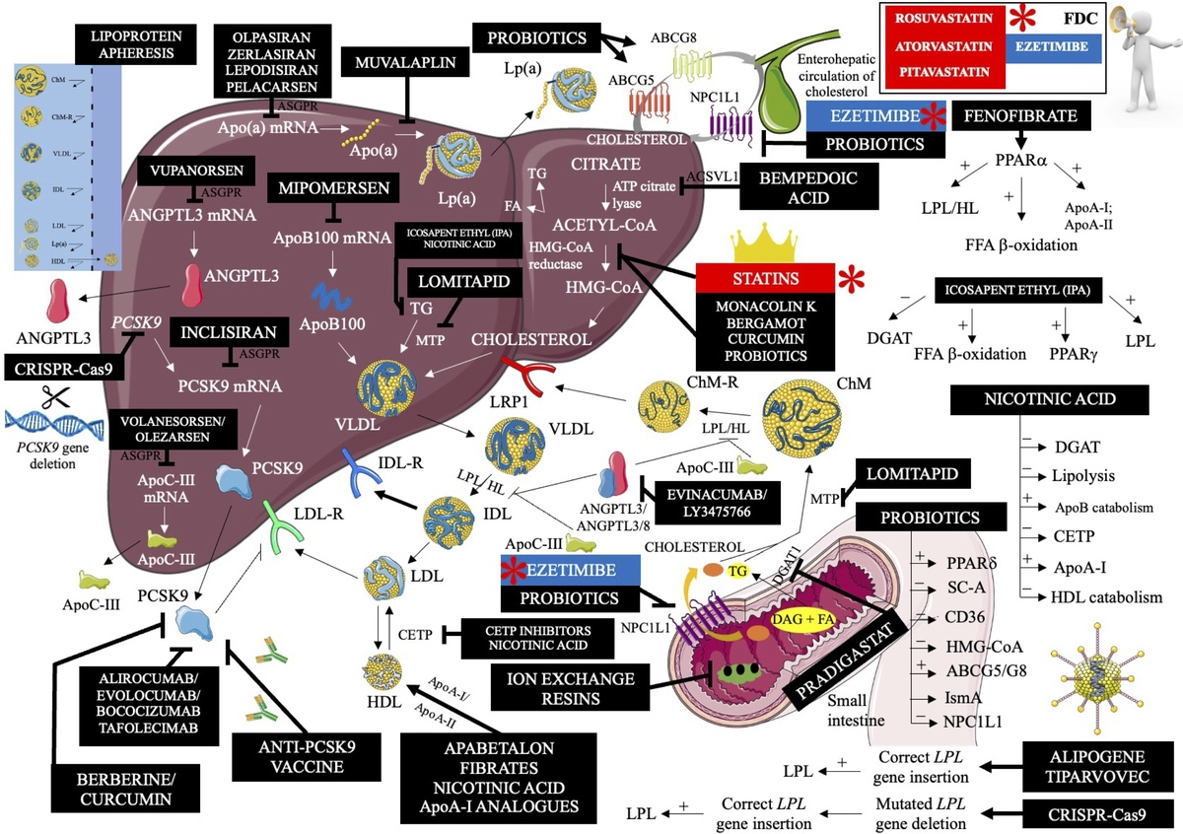

2023: The year in cardiovascular disease – the year of new and prospective lipid lowering therapies. Can we render dyslipidemia a rare disease by 2024?
DOI: 10.5114/aoms/174743
Arch Med Sci 2023;19(6):1602-1615
Notes:
In 2023 there are still even 75% of patients over the target of low-density lipoprotein cholesterol (LDL-C), and hypercholesterolemia is the most common and the worst monitored cardiovascular risk factor. How it is possible, considering the knowledge we have on the role of cholesterol in the process of atherosclerosis, atherosclerotic cardiovascular disease (ASCVD) and its complications, on the methods of lipid disorders diagnosis, prevention, and treatment. Nowadays, almost 4 million deaths per year are attributed to LDL-C, and even 2/3 of all CVD deaths to ASCVD, therefore hypothetically we should easily prevent few to several million of deaths with early diagnosis, and early and intensive non-pharmacological and pharmacological therapies. Moreover, lipidology is now, besides oncology, the area with the highest number of new and ongoing trials with new effective and safe medications that have already appeared and will soon be available. Therefore, we have no doubt that year 2023 should be called the year of new and prospective lipid lowering therapies (LLTs). In this State-of-the-Art paper we summarized the most important trials, studies, and recommendations on the new and prospective LLTs, with suitable graphical summaries that might be helpful for the physicians in their practice with a look to the nearest future with prospective therapies being still under investigation. Let’s hope all those medications helps to render dyslipidemia a rare disease in next few years.

