Slide 1
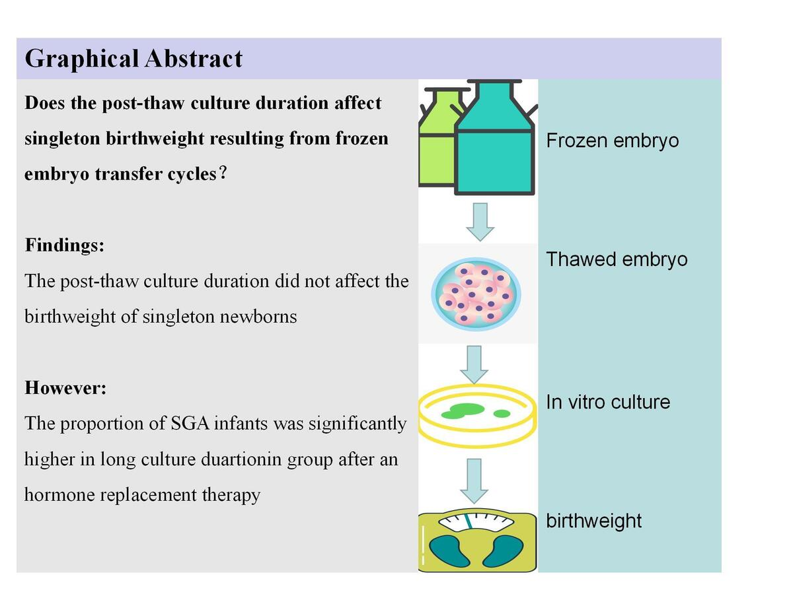

The effect of post-thaw culture duration on singleton birthweight resulting from frozen embryo transfer cycles
DOI: 10.5114/aoms/174868
Arch Med Sci 2025;21(3):852-857
Notes:
Introduction
We aimed to explore the possible link between the post-thaw culture duration and singleton birthweight resulting from frozen embryo transfer (FET) cycles.
Material and methods
In this retrospective study, 216 singletons were analyzed between January 2017 and December 2018 in our center. FET cycles were allocated to two main groups based on the interval between the moment of thawing and embryo transfer. The main outcome measure was the birthweight of singletons after FET. The confounding factors for singleton birthweight were evaluated using multiple linear regression analysis.
Results
The mean singleton birthweight resulting from the long culture transfer group was not significantly different from singletons resulting from the short culture transfer group. The z-scores for singletons were also not significantly different; however, the long culture transfer group had a higher proportion of small for gestational age (SGA) than the short culture transfer group. Using multiple linear regression analysis, we found that infant gender, gestational age and maternal BMI significantly affect singleton birthweight, while the duration of post-thaw culture had no effects on newborn birthweight.
Conclusions
Our study suggested that post-thaw culture duration did not affect the birthweight of singleton newborns. But singleton newborns from long post-thaw culture after a hormone replacement therapy (HRT) may have a higher risk of SGA.

