Slide 1
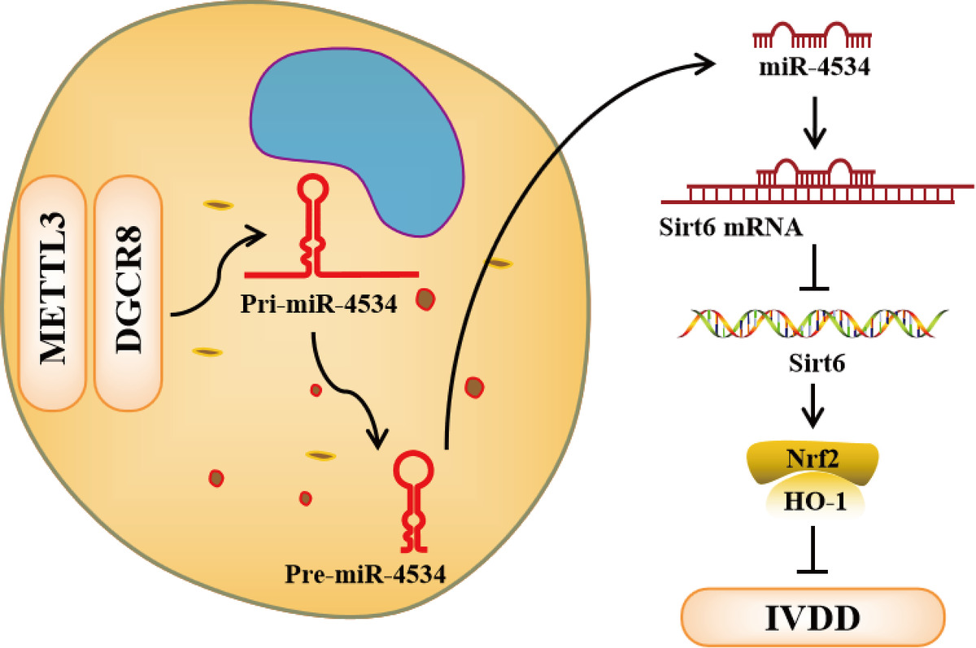

METTL3-mediated miR-4534 maturation promotes IVDD progression by targeting the Sirt6-mediated Nrf2/HO-1 pathway
DOI: 10.5114/aoms/175495
Arch Med Sci 2025;21(6):2795-2813
Notes:
Introduction
Intervertebral disc degeneration (IVDD) is a significant contributor to the development of discogenic low back pain and impairment. Apoptosis and degradation of the extracellular matrix (ECM) have also been reported to be major factors in IVDD. However, current treatments are unable to cure it, and the exact mechanisms are not fully understood.
Material and methods
Nucleus pulposus (NP) tissues were collected from individuals diagnosed with either IVDD or lumbar vertebral fractures, whereas nucleus pulposus cells (NPCs) were isolated from non-degenerative, healthy NP tissues. The IVDD cell model was established by treating NPCs with IL-1β at a concentration of 20 ng/ml, and an animal model was induced through annulus fibrosus puncture surgery. Histological examination of NP tissues was performed using HE staining. Analysis of mRNA and protein expression was performed using qRT-PCR and western blot techniques. Cellular viability was assessed using the CCK-8 assay, flow cytometry and TUNEL assays were employed to evaluate cellular apoptosis, the binding interaction between miR-4534 and Sirt6 was confirmed via a dual-luciferase reporter system, and we utilized RIP and Me-RIP methods to provide evidence of m6A modification in pri-miR-4534.
Results
MiR-4534 was found to be upregulated in NP tissues affected by IVDD, and it promoted apoptosis of NPCs and ECM degradation by inhibiting Sirt6 expression and inactivating the Nrf2/HO-1 pathway. Furthermore, this upregulation was attributed to m6A epigenetic modification of pri-miR-4534, facilitated by METTL3, and the knockdown of METTL3 alleviated the progression of IVDD.
Conclusions
MiR-4534, upregulated through METTL3-mediated m6A modification, functions by suppressing Sirt6 and deactivating the Nrf2/HO-1 pathway, which, in turn, promotes apoptosis of NPCs and contributes to ECM degradation, thereby facilitating the progression of IVDD.

