Slide 1
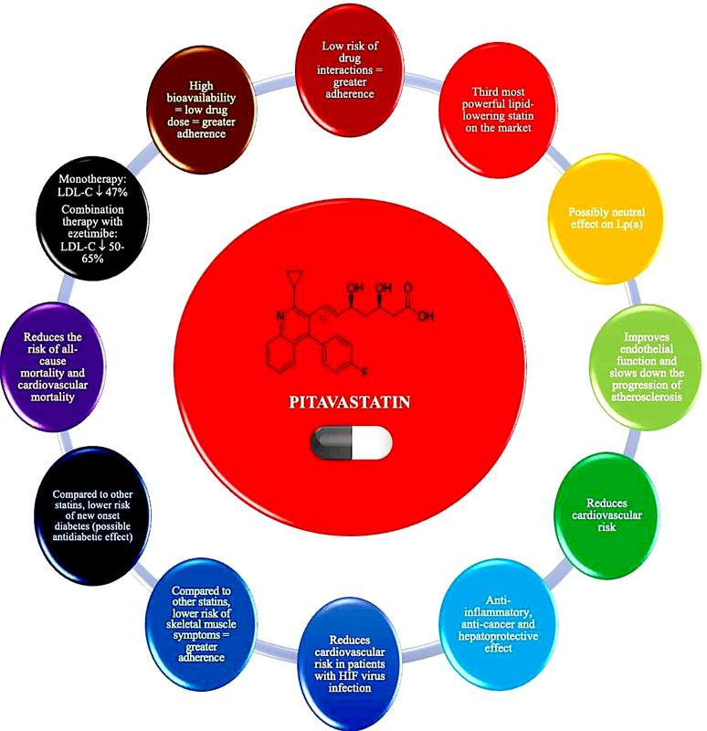

Position paper of the Polish Expert Group on the use of pitavastatin in the treatment of lipid disorders in Poland endorsed by the Polish Lipid Association
DOI: 10.5114/aoms/175879
Arch Med Sci 2024;20(1):28-42
Notes:
Lipid disorders, primarily hypercholesterolemia, are the most common cardiovascular (CV) risk factor in Poland (this applies even 3/4 of people). The low-density lipoprotein cholesterol (LDL-C) serum level is the basic lipid parameter that should be measured to determine CV risk and determines the aim and target of lipid-lowering treatment (LLT). Lipid-lowering treatment improves cardiovascular prognosis and prolongs life in both primary and secondary cardiovascular prevention. Despite the availability of effective lipid-lowering drugs and solid data on their beneficial effects, the level of LDL-C control is highly insufficient. This is related, among other things, to physician inertia and patients’ fear of side effects. The development of lipidology has made drugs available with a good safety profile and enabling personalisation of therapy. Pitavastatin, the third most potent lipid-lowering statin, is characterised by a lower risk of muscle complications and new cases of diabetes due to its being metabolised differently. Thus, pitavastatin is a very good therapeutic option in patients at high risk of diabetes or with existing diabetes, and in patients at cardiovascular risk. This expert opinion paper attempts at recommendation on the place and possibility of using pitavastatin in the treatment of lipid disorders.

