Slide 1
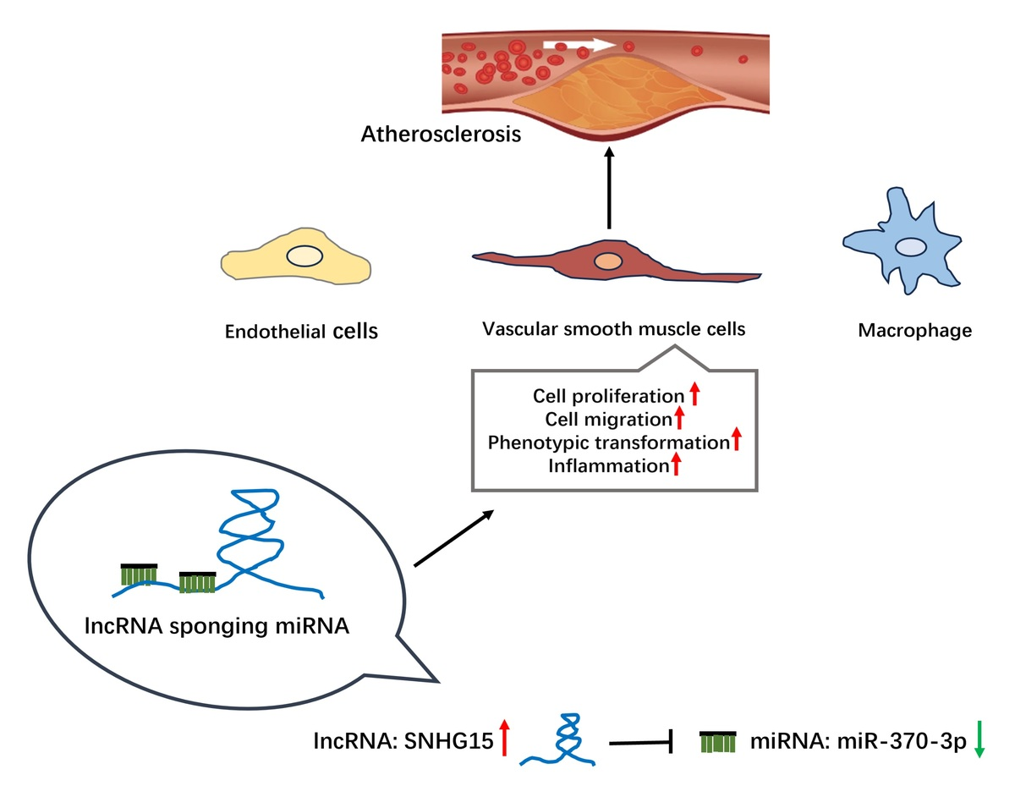

SNHG15 is involved in the progression of atherosclerosis through targeted regulation of miR-370-3p and bioinformatics analysis
DOI: 10.5114/aoms/176676
Arch Med Sci 2026;22(1):301-315
Notes:
Introduction
This study aimed to explore the expression of SNHG15 in atherosclerotic population and further evaluate the regulatory mechanism of SNHG15 in AS.
Material and methods
qRT-PCR was used to detect the level of SNHG15 in serum samples. An in vitro cell model was constructed using 50 µg/ml ox-LDL-induced VSMCs. Transwell, CCK-8 assay and ELISA were used to detect the migration, proliferation, phenotypic transformation, and inflammatory reaction of the cell model. The interaction between SNHG15 and miR-370-3p was verified by the luciferase reporter gene. Pearson analysis was used to assess the correlation between SNHG15 and miR-370-3p. The target genes of miR-370-3p and their functions were evaluated by bioinformatics analysis.
Results
The expression of SNHG15 in the AS group and ox-LDL-induced VSMCs group were upregulated (p < 0.001), while miR-370-3p was decreased (p < 0.001). In vitro studies showed that inhibition of SNHG15 can obviously weaken the proliferation, migration, phenotypic transformation, and inflammation of VSMCs induced by ox-LDL (p < 0.01). Bioinformatics and luciferase reporter gene confirmed that miR-370-3p was the downstream target gene of SNHG15. Pearson correlation coefficient revealed that miR-370-3p was negatively regulated by SNHG15 (r = –0.6998, p < 0.001). Bioinformatics analysis indicated that miR-370-3p had 160 potential target genes, whose functions were mainly related to cell cycle and cell adhesion, and were mainly concentrated in the MAPK signaling pathway. Further analysis showed that the downstream target gene of miR-370-3p was FOXO1.
Conclusions
SNHG15 mediated cell proliferation, migration, phenotypic transformation, and inflammation response via inhibiting miR-370-3p in ox-LDL-induced VSMCs.

