Slide 1
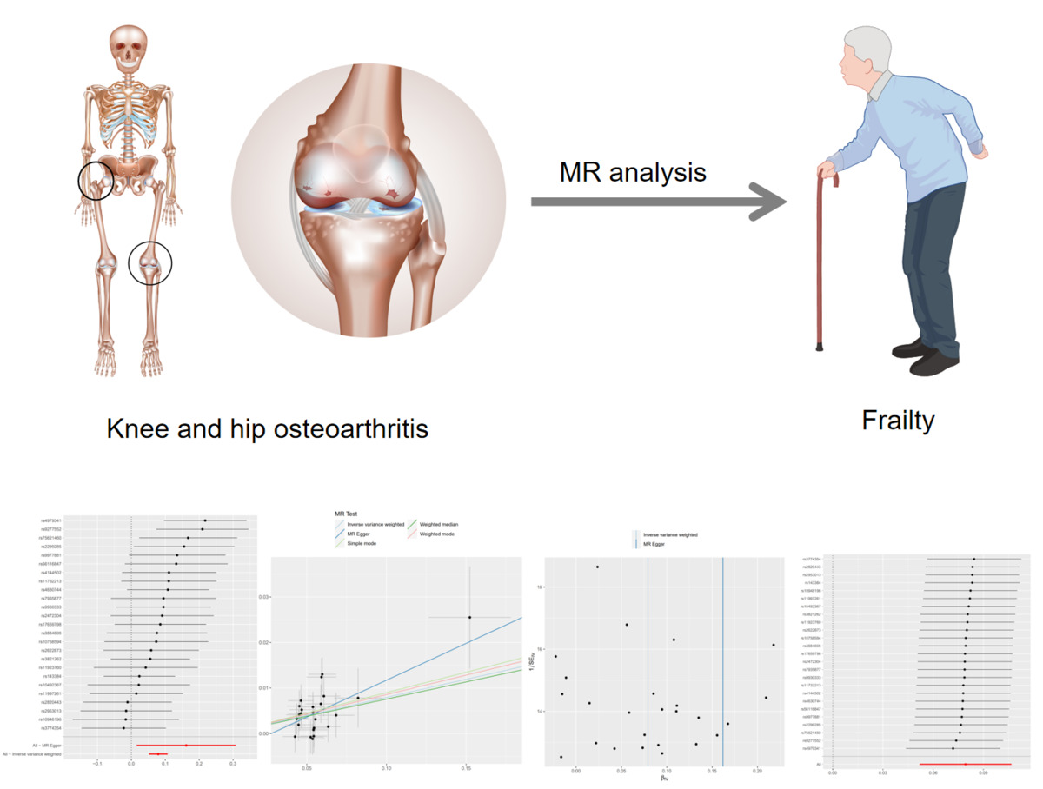

The genetic causal association between hip or knee osteoarthritis and frailty: a two-sample Mendelian randomization analysis
DOI: 10.5114/aoms/176741
Arch Med Sci 2024;20(3):938-946
Notes:
Introduction
Osteoarthritis of the hip or knee has been reported to be linked to an increased risk of frailty. However, a definitive conclusion about whether hip or knee osteoarthritis increases susceptibility to frailty remains elusive.
Material and methods
The instrumental variables (IVs) used in this analysis were sourced from publicly available genome-wide association study (GWAS) datasets. We used a two-sample Mendelian randomization analysis to evaluate the plausible causal nexus between hip or knee osteoarthritis and frailty.
Results
We included a total of 25 single-nucleotide polymorphisms (SNPs) as instrumental variables through rigorous and comprehensive screening. The results of this analysis suggested that hip or knee osteoarthritis is associated with an elevated risk of frailty. These results remained robust and consistent across multiple calculation methods, including inverse variance weighted (OR = 1.082, 95% CI: 1.0532–1.1125, p = 1.36 × 10–8), MR‒Egger regression (OR = 1.175, 95% CI: 1.0162–1.3604, p = 0.040), weighted median estimation (OR = 1.078, 95% CI: 1.0365–1.1219, p = 1.831 × 10–4), weighted mode analysis (OR = 1.089, 95% CI: 1.0078–1.1771, p = 0.041) and simple mode analysis (OR = 1.093, 95% CI: 1.0112–1.1830, p = 0.034). Cochran’s Q test showed no evidence of heterogeneity among the IV estimates derived from individual variants, and the MR‒Egger regression analysis indicated that the presence of horizontal pleiotropy was unlikely to introduce bias into the results (intercept: –0.0044, p = 0.549).
Conclusions
Two-sample Mendelian randomization analysis effectively identified hip or knee osteoarthritis as a contributing risk factor for frailty.

