Slide 1
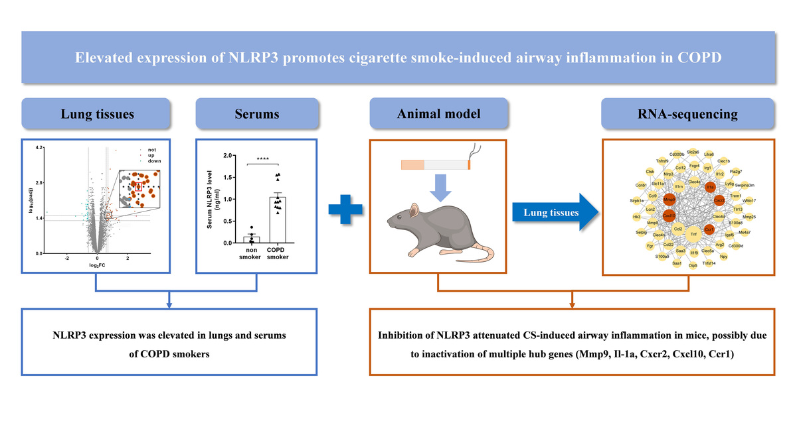

Elevated expression of NLRP3 promotes cigarette smoke-induced airway inflammation in chronic obstructive pulmonary disease
DOI: 10.5114/aoms/176805
Arch Med Sci 2024;20(4):1281-1293
Notes:
Introduction
NOD-like receptor protein 3 (NLRP3) is implicated in chronic obstructive pulmonary disease (COPD) pathogenesis. Here, we explored the role of NLRP3 in cigarette smoke (CS)-induced airway inflammation in COPD.
Material and methods
NLRP3 expression level was assessed with the microarray data in GEO datasets and validated in serum by ELISA from a case-control cohort. Male C57BL/6J mice were randomly divided into: saline, CS, MCC950 (a specific NLRP3 inhibitor, 10 mg/kg) and CS + MCC950 (5 mg/kg and 10 mg/kg) groups (n = 5 per group). All mice were exposed to CS or air for 4 weeks. Then, broncho-alveolar lavage (BAL) fluid and lung tissues were collected for cell counting, ELISA, HE staining and RNA sequencing with validation by real-time qPCR.
Results
Compared to non-smokers, NLRP3 expression was significantly elevated in the lung tissues and sera of COPD smokers. CS remarkably induced airway inflammation in mice, characterized by an increase of inflammatory cells and proinflammatory cytokines in BAL fluid and HE inflammatory score, which were ameliorated by MCC950 treatment dose-dependently. Subsequently, 84 candidate genes were selected following RNA sequencing, and five hub genes (Mmp9, IL-1α, Cxcr2, Cxcl10, Ccr1) were then identified by PPI and MCODE analyses, which were confirmed by real-time qPCR. GO and KEGG analysis suggested that the five genes were enriched in a complicated network of inflammatory processes and signaling pathways.
Conclusions
NLRP3 expression is elevated in lungs and sera of COPD smokers. Inhibition of NLRP3 significantly attenuates CS-induced airway inflammation in mice via inactivation of multiple hub genes and their related inflammatory processes and signaling pathways.

