Slide 1
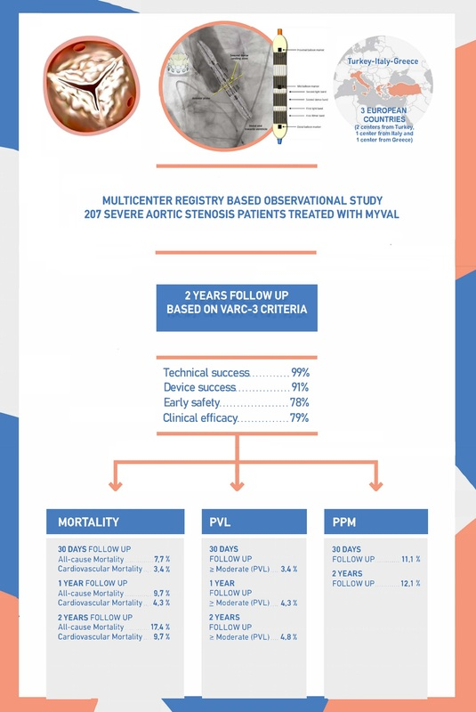

Clinical outcomes of the Myval transcatheter heart valve system in patients with severe aortic valve stenosis: a two-year follow-up observational study
DOI: 10.5114/aoms/176937
Arch Med Sci 2024;20(2):410-419
Notes:
Introduction
Limited data exist on long-term follow-up of severe aortic stenosis (SAS) patients who have undergone transcatheter aortic valve implantation (TAVI) with a new generation, balloon expandable Myval transcatheter heart valve (THV). Thus, we sought to investigate the performance and 2-year clinical outcome of the Myval THV system based on Valve Academic Research Consortium-3 (VARC-3) criteria.
Material and methods
A multi-centre, registry-based, observational study was conducted, which included 207 consecutive degenerative SAS patients, from Turkey (n = 128), Italy (n = 58), and Greece (n = 21) (mean [standard deviation] 81 (7) years, 94 [45%] men; 73% NYHA III or IV; EuroSCORE II 5.2% [2.4%]); all patients underwent TAVI with Myval. Patients were followed up at 1 year and 2 years after implantation. Clinical and procedural outcomes were defined according to VARC-3 criteria.
Results
Technical success was observed in 204 (99%), device success was observed in 189 (91%), early safety was observed in 161 (78%), and clinical efficacy was observed in 163 (79%) patients. The 30-day death rate was 7.7%; of these, 3.4% were due to cardiovascular reasons. All-cause and cardiovascular mortality rates were 9.7% and 4.3% at 1-year follow-up, and 17.4% and 9.7% at 2-year follow-up, respectively. Incidence of ≥ moderate paravalvular leak (PVL) at 30 days, 1 year and 2 years of follow-up were 3.4%, 4.3% and 4.8%. A total of 11.1% of patients required a permanent pacemaker implantation (PPI) at 30 days after implantation, while the cumulative rate of PPI at 2 years was 12.1%.
Conclusions
In this cohort of patients with SAS, the Myval was found to be safe and effective in up to 2 years of follow-up.

