Slide 1
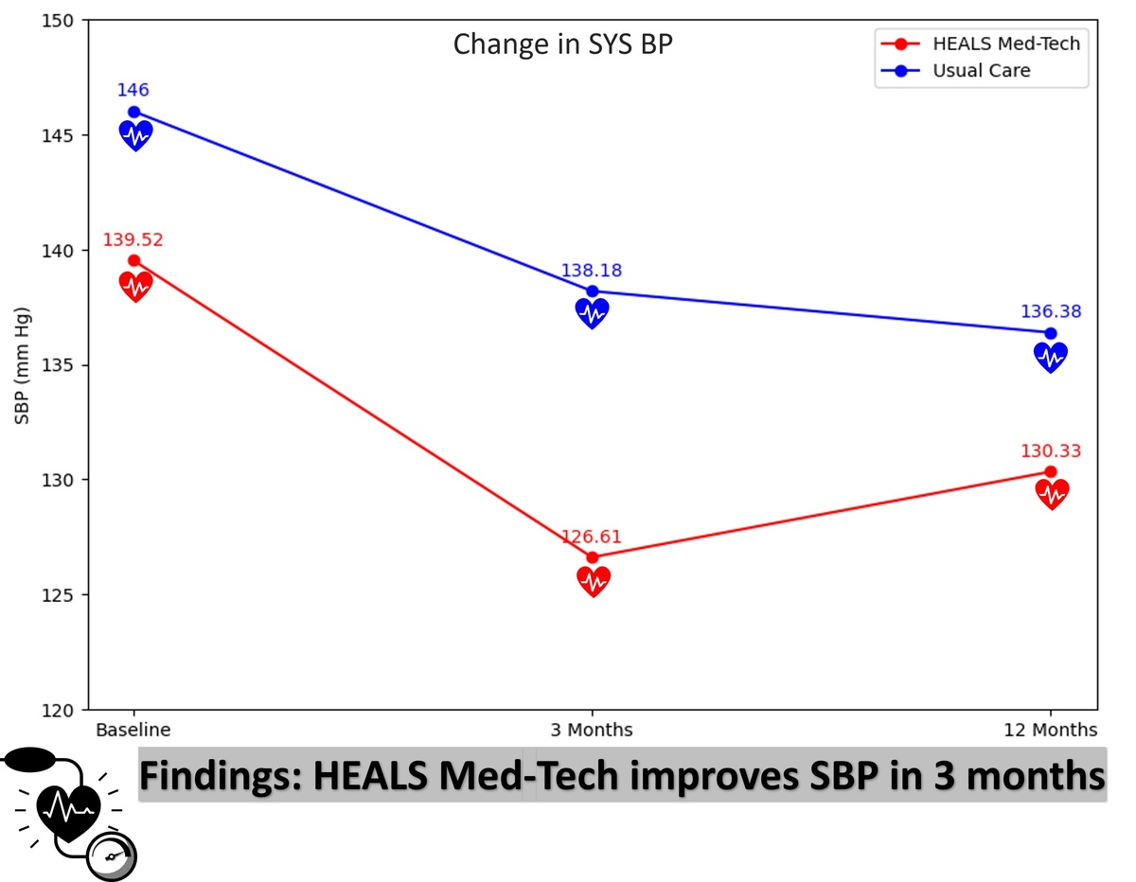

The impact of a Telehealth-based Behavioral Lifestyle Program on hypertension control in African American participants: results from the HEALS Med-Tech randomized controlled trial
DOI: 10.5114/aoms/177686
Arch Med Sci 2024;20(1):309-312
Notes:
Introduction
The HEALS Med-Tech program offers a unique blend of lifestyle changes and technology to improve hypertension (HTN) management in African Americans (AAs), a group disproportionately affected by cardiovascular disease (CVD).
Methods
A randomized controlled trial compared HEALS Med-Tech against usual care for uncontrolled hypertension in AAs, focusing on diet, medication adherence, and telehealth.
Results
In a study of 61 participants, HEALS Med-Tech significantly reduced systolic blood pressure by 12.95 mm Hg (p = 0.008) and 9.19 mm Hg (p = 0.013) at 3 and 12 months, respectively, demonstrating improved hypertension control.
Conclusions
HEALS Med-Tech demonstrates potential in HTN management for AAs, advocating for culturally tailored, tech-integrated healthcare expansion.

