Slide 1
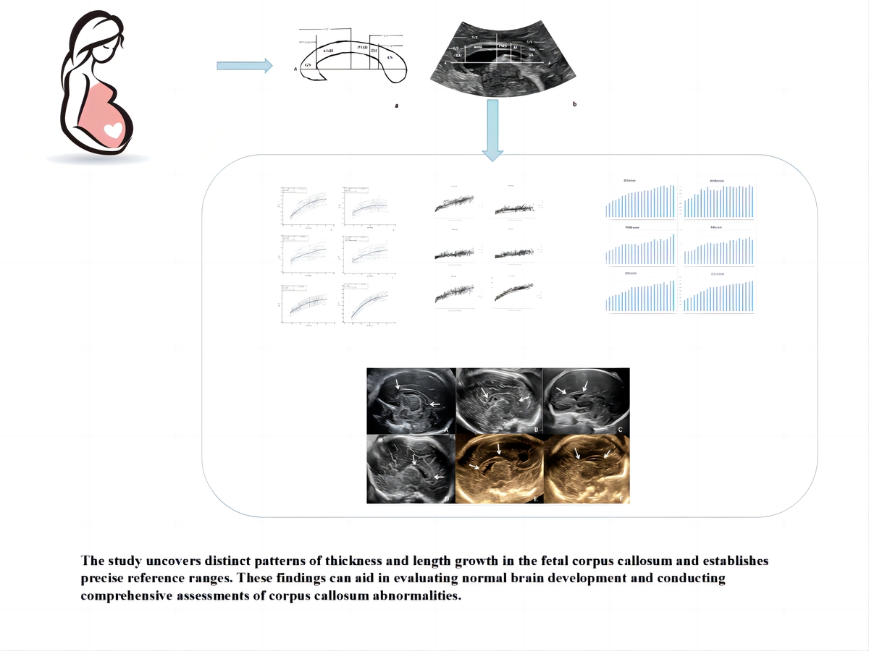

Prenatal ultrasound reassessment of the corpus callosum based on cortical connectivity information
DOI: 10.5114/aoms/178184
Arch Med Sci 2025;21(4):1289-1298
Notes:
Introduction
Routine prenatal ultrasound assessment of the corpus callosum (CC) does not reflect information on fibrous connections. The primary purpose was to construct detailed reference ranges of quantitative characteristics of the foetal CC based on cortical connectivity information. Secondary goals were to examine for sex differences and assess the validity of the measurement technique for cases with CC dysplasia.
Material and methods
Pregnant women referred to a tertiary centre for sonographic examination were recruited to undergo a detailed foetal scan from 19 to 40 weeks. The foetal CC was divided into 5 distinct segments using the Hofer & Frahm classification technique. The thickness of each segment and the overall length of the CC were measured. Additionally, a segmental evaluation was conducted on partial agenesis of the CC. The inter- and intraobserver variability were assessed by interclass correlation coefficients. Regression analysis was used to determine the association between the biological measurements and gestational age.
Results
A total of 852 foetuses (403 males and 449 females) were included in the final analysis. Intra- and interobserver reliability coefficients ranged from 0.86 to 0.98 and 0.84 to 0.97, respectively. Reference ranges were established for the thickness and length of its segments. We observed that the biometric measurements of the foetal CC showed a curvilinear increase with gestational age. There was a statistically significant sex effect for the CC. At the average gestation age 29.6 weeks, the genu, anterior midbody, posterior midbody, and isthmus of male foetuses were 0.06280 mm, 0.04435 mm, 0.01731 mm, and 0.01556 mm, respectively, thicker than those of female foetuses, whereas the splenium of the female foetus was 0.06583 mm thicker than the male foetus.
Conclusions
The study uncovers distinct patterns of thickness and length growth in the foetal CC and establishes precise reference ranges. These findings can aid in evaluating normal brain development and conducting comprehensive assessments of CC abnormalities.

