Slide 1
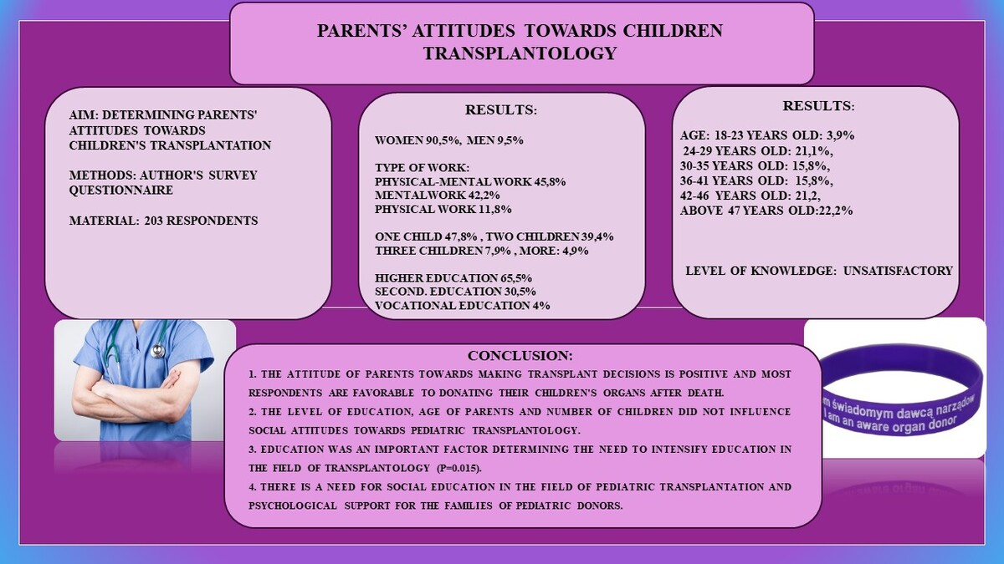

Parents’ attitudes towards children’s transplantology
DOI: 10.5114/aoms/178277
Arch Med Sci 2024;20(1):326-331
Notes:
Introduction
Pediatric transplantation is an extremely complex and emotionally difficult area of pediatric medicine. The process of obtaining a pediatric donor by the staff is an extremely delicate topic, and for the family of the deceased child, often an unimaginable and painful process. The aim of the study was to analyze parents’ opinions on pediatric transplantology.
Methods
The research survey method was applied using an original survey questionnaire made available electronically using a Google form. The group analyzed included 203 respondents.
Results
The attitude towards making transplant decisions among the respondents was positive. Education, age of parents and number of children did not influence attitudes towards pediatric transplantology.
Conclusions
There is a need for social education in the field of pediatric transplantation and to facilitate access to professional psychological care for pediatric patients and/or their caregivers.

