Slide 1
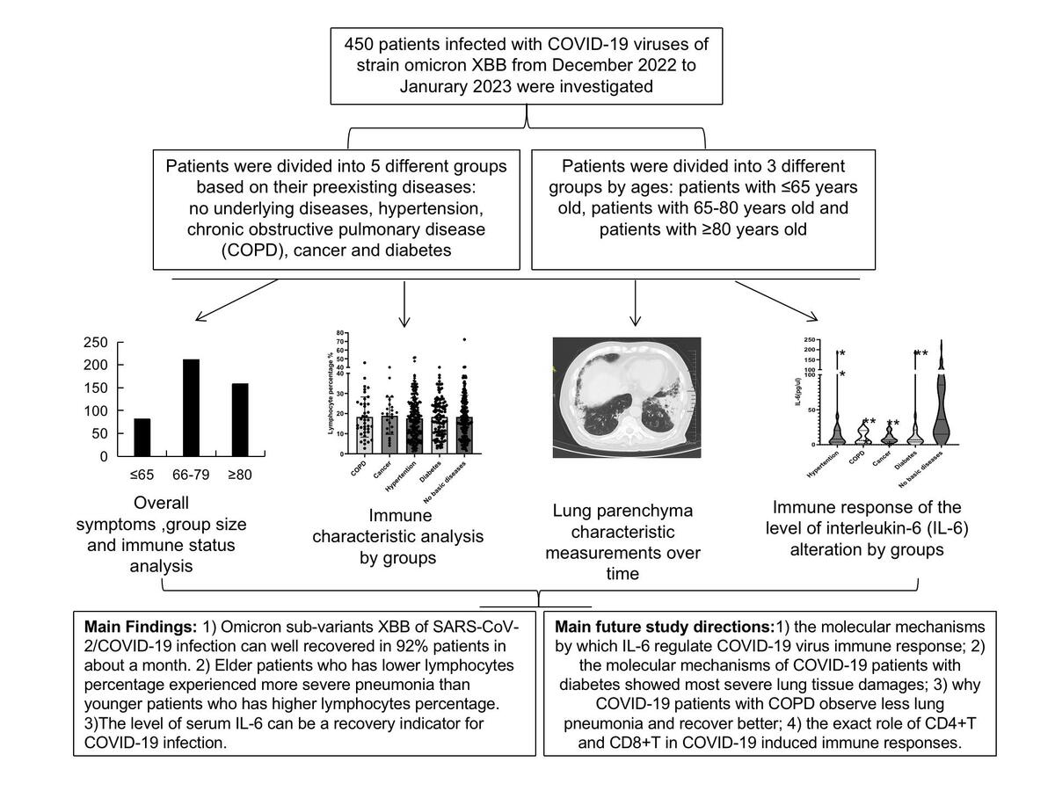

A comprehensive analysis of immune characteristics and clinical prognosis in Asian COVID-19 patients infected with SARS-CoV-2 Omicron strain XBB sub-variants: a retrospective study of 450 cases
DOI: 10.5114/aoms/178422
Notes:
Introduction
The pandemic of coronavirus disease 2019 (COVID-19), caused by severe acute respiratory syndrome coronavirus-2 (SARS-CoV-2), has posed a severe threat to human health since December 2019. Immune characteristics and clinical symptoms manifested by COVID-19 patients of the most recent new strains have not been reported.
Material and methods
We retrospectively investigated 450 patients with laboratory-confirmed COVID-19 infection from December 2022 to January 2023. Clinical information and peripheral blood of the patients were obtained and analyzed for serum IL-6 levels and T cell sub-types. Post hoc analysis was performed to uncover immunological and involved COVID-19-associated pneumonia differences between patients with different underlying diseases and ages.
Results
The median age of the patients was 75.5 years old. 60% of the patients were male and 40% were female. The most common symptoms were cough (344/450,76.4%), fever (317/450, 70.4%), expectoration (199/450, 44.2%) and wheeze (143/450, 31.8%). The mean hospital stay was 11.85 days (range: 1–57). 92% of the patients recovered in a month. The level of serum IL-6 was significantly higher in patients without underlying diseases compared with patients with hypertension, chronic obstructive pulmonary disease (COPD), cancer and diabetes (p < 0.001). Serum IL-6 level was significantly higher in patients who were 66–79 years old than that in patients aged 65 years and younger (p < 0.001). Peripheral CD8+T cell percentage was significantly higher in patients aged 65 years and younger than that in patients aged 80 years and older (p = 0.05). The mean involved ground-glass opacity area of the lung of all studied patients found by chest computed tomography (CT) at the time of initial onset of symptoms was 35.7%. Fifty-seven out of 132 (43.2%) patients who had assessable CT scans at 4–12 weeks after infection completely recovered with no chest CT abnormality. Involved ground-glass area of the lung of patients with diabetes or without underlying disease was significantly more severe than that in patients with COPD (p = 0.041 and p = 0.017, respectively). Involved ground-glass area of the lung of patients aged 80 years and older was significantly more severe than that in patients aged 65 years and younger (p = 0.031).
Conclusions
92% of COVID-19 patients infected with Omicron XBB sub-variants of SARS-CoV-2 can recover well in a month. Patients aged 80 years and older who have a lower lymphocyte percentage experienced more severe pneumonia than patients aged 65 years and younger having a higher lymphocyte percentage. Serum IL-6 level can be a recovery indicator for patients with COVID-19 infection.

