Slide 1
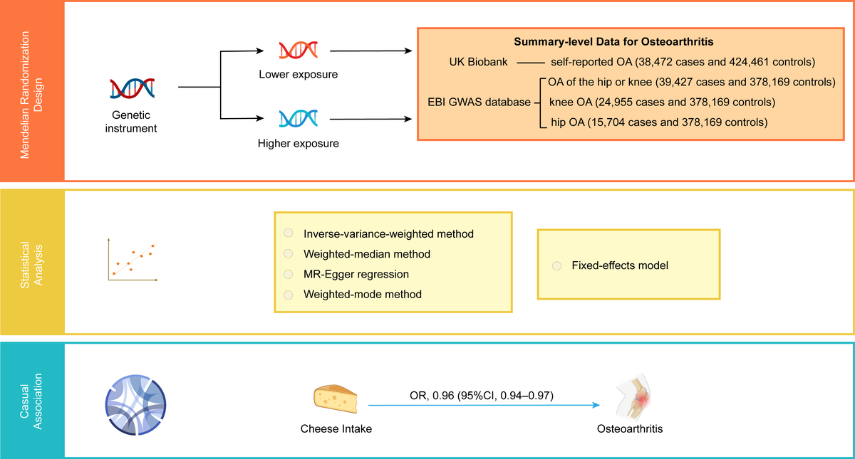

The effect of cheese intake on osteoarthritis: a Mendelian randomization study
DOI: 10.5114/aoms/182910
Arch Med Sci 2024;20(6):1943-1956
Notes:
Introduction
Osteoarthritis (OA) is a debilitating chronic disease with a high prevalence, characterized by progressive degeneration of articular cartilage that leads to joint dysfunction, pain, and disability. Observational studies investigating the link between cheese intake and OA have yielded inconclusive results and may be susceptible to confounding.
Material and methods
We performed a two-sample Mendelian randomization (MR) investigation to evaluate the causal association between cheese intake and OA based on genome-wide association studies (GWAS). The primary analysis employed the inverse variance weighted (IVW) method, while complementary analyses were conducted using the weighted median, MR-Egger, and weighted mode methods. Moreover, we weighted each single nucleotide polymorphism’s (SNP) effect on OA by its effect on cheese intake and subsequently meta-analyzed these estimates utilizing a fixed-effects model to provide a summary effect estimate. To assess the robustness of the outcomes, we performed a sensitivity analysis.
Results
Our two-sample MR analysis revealed an inverse causal relationship between cheese intake and several types of OA, including self-reported OA (odds ratio (OR) = 0.96, 95% confidence interval (CI) = 0.94–0.97, p = 6.70 × 10–7), OA of the hip or knee (OR = 0.59, 95% CI = 0.48–0.72, p = 1.38 × 10–7), knee OA (OR = 0.52, 95% CI = 0.42–0.66, p = 4.11 × 10–8), and hip OA (OR = 0.72, 95% CI = 0.53–0.96, p = 0.0268). Additionally, the fixed-effects model also demonstrated a causal inverse association between cheese intake and OA, with a pooled meta-analysis OR of 0.95 (95% CI = 0.94–0.97, p < 0.0001).
Conclusions
Our findings provided compelling genetic evidence of causal inverse associations between cheese intake and various types of OA, including self-reported OA, OA of the hip or knee, knee OA, and hip OA, which may enhance the efficacy of OA prevention by deepening our comprehension of the involved risk factors.

