Slide 1
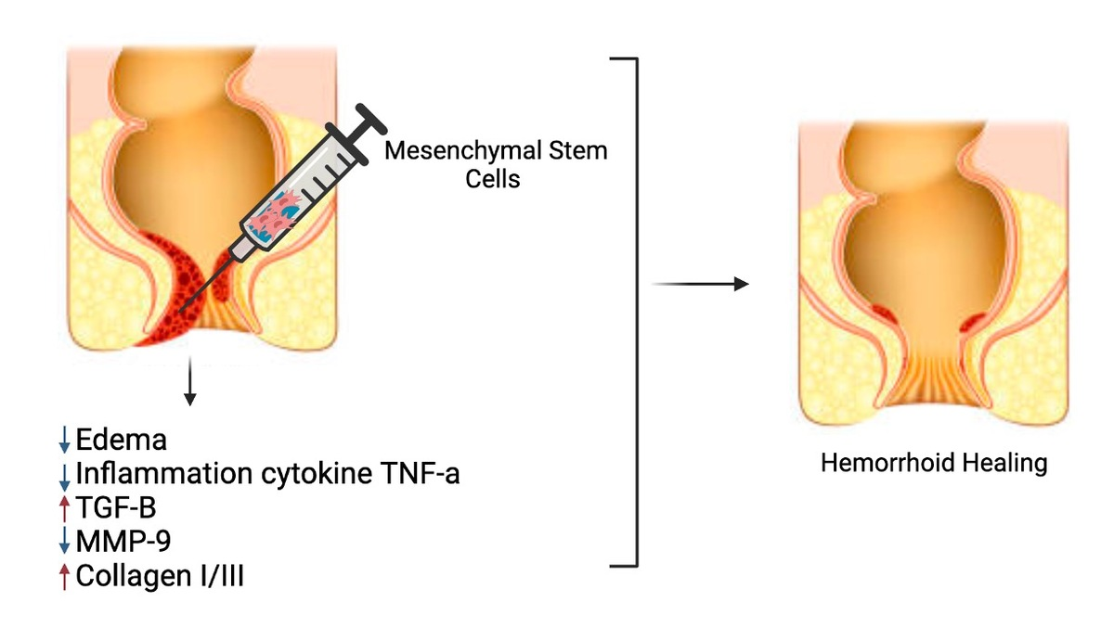

Synergistic therapeutic approach for hemorrhoids: integrating mesenchymal stem cells with diosmin-hesperidin to target tissue edema and inflammation
DOI: 10.5114/aoms/183465
Arch Med Sci 2024;20(5):1556-1566
Notes:
Introduction
Mesenchymal stem cells (MSCs) have promising regenerative properties in tissue repair and anti-inflammatory responses. This study aimed to investigate the effects of MSCs and their combination with micronized purified flavonoid fraction (MPFF) in a croton oil-induced hemorrhoids model on tissue edema, inflammation, and underlying molecular mechanisms.
Material and methods
MSCs were isolated and characterized for their adherence, differentiation capacity, and immunophenotyping. Croton oil-induced hemorrhoid mouse models were established to assess tissue edema, inflammation, tumor necrosis factor (TNF-α) expression, transforming growth factor-β (TGF-β) expression, collagen ratio, and MMP-9 activity. The effects of MSCs and their combination with MPFF (diosmin-hesperidin) were evaluated through histological examinations, western blot analysis, and gelatin zymography.
Results
Characterization confirmed the MSCs’ plastic adherence, osteogenic differentiation potential, and immunophenotype (positive for CD90 and CD29, negative for CD45 and CD31). Treatment with MSCs alone or in combination with MPFF significantly reduced tissue edema, inflammation, TNF-α expression, and MMP-9 activity. Additionally, MSCs increased TGF-β expression, and collagen type I/III ratio, and accelerated wound healing by resolving inflammation.
Conclusions
These findings suggest that MSCs play a crucial role in modulating TNF-α, TGF-β, collagen remodeling, and MMP-9 activity, highlighting their promising role in hemorrhoid treatment and wound healing processes. Further research is warranted to fully elucidate the intricate mechanisms and optimize MSC-based therapies for clinical applications in hemorrhoidal disease management.

