Slide 1
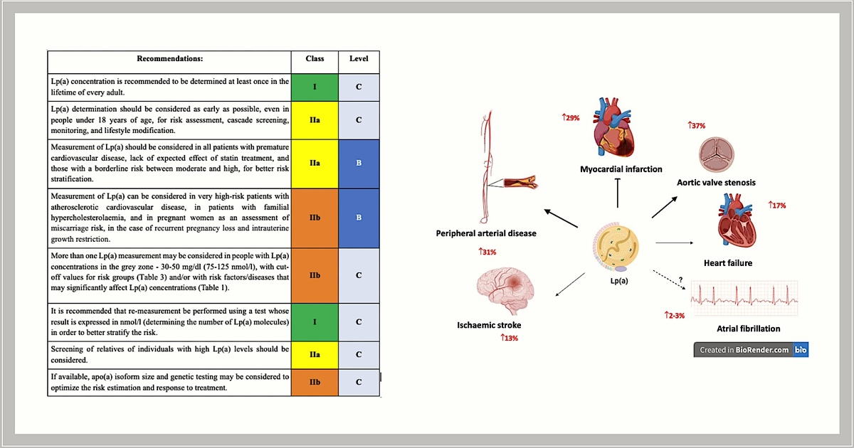

Recommendations of the Experts of the Polish Cardiac Society (PCS) and the Polish Lipid Association (PoLA) on the diagnosis and management of elevated lipoprotein(a) levels
DOI: 10.5114/aoms/183522
Arch Med Sci 2024;20(1):8-27
Notes:
Lipoprotein(a) [Lp(a)] is made up of a low-density lipoprotein (LDL) particle and a specific apolipoprotein(a). The blood concentration of Lp(a) is approximately 90% genetically determined, and the main genetic factor determining Lp(a) levels is the size of the apo(a) isoform, which is determined by the number of KIV2 domain repeats. The size of the apo(a) isoform is inversely proportional to the blood concentration of Lp(a). Lp(a) is a strong and independent cardiovascular risk factor. Elevated Lp(a) levels ≥ 50 mg/dl (≥ 125 nmol/l) are estimated to occur in more than 1.5 billion people worldwide. However, determination of Lp(a) levels is performed far too rarely, including Poland, where, in fact, it is only since the 2021 guidelines of the Polish Lipid Association (PoLA) and five other scientific societies that Lp(a) measurements have begun to be performed. Determination of Lp(a) concentrations is not easy due to, among other things, the different sizes of the apo(a) isoforms; however, the currently available certified tests make it possible to distinguish between people with low and high cardiovascular risk with a high degree of precision. In 2022, the first guidelines for the management of patients with elevated lipoprotein(a) levels were published by the European Atherosclerosis Society (EAS) and the American Heart Association (AHA). The first Polish guidelines are the result of the work of experts from the two scientific societies and their aim is to provide clear, practical recommendations for the determination and management of elevated Lp(a) levels.

