Slide 1
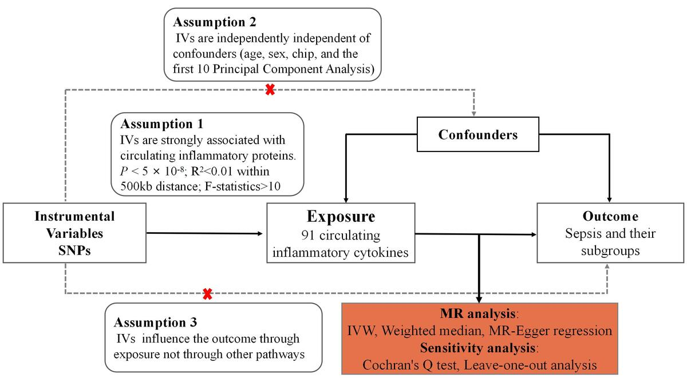

Causal associations of circulating inflammatory proteins with sepsis: a two-sample Mendelian randomization study
DOI: 10.5114/aoms/183945
Arch Med Sci 2025;21(5):1898-1906
Notes:
Introduction
Sepsis arises from dysregulated inflammation in response to infection, precipitating organ dysfunction. Circulating inflammatory mediators likely contribute to sepsis pathogenesis, but their precise roles remain unclear. We aimed to evaluate potential causal impacts of inflammatory proteins on sepsis risk.
Material and methods
We performed a two-sample Mendelian randomization study evaluating causal associations for 91 inflammatory proteins with sepsis risk. Genetic instruments were derived from a published genome-wide association study of plasma proteins. Sepsis outcome data were obtained from the UK Biobank and FinnGen cohort. Inverse-variance weighted analysis was conducted along with several sensitivity analyses.
Results
The analyses identified significant causal associations for several inflammatory proteins with sepsis risk. TRAIL exhibited a causal effect on increased overall sepsis risk (OR = 1.10, 95% CI: 1.03–1.17). CCL28 showed a causal link to higher 28-day sepsis mortality in critical care (OR = 3.32, 95% CI: 1.18–9.29). CCL4 demonstrated a causal association with increased 28-day sepsis mortality (OR = 1.81, 95% CI: 1.06–1.31). Meanwhile, beta-NGF was found to be causally protective for sepsis (OR = 0.77, 95% CI: 0.60–0.99), and TNFB also showed a causally protective effect (OR = 0.95, 95% CI: 0.91–1.00).
Conclusions
Our study elucidates roles of inflammatory mediators in sepsis pathogenesis. The identified proteins may serve as biomarkers or therapeutic targets. TRAIL signaling inhibition may hold promise for future clinical translation given its causal links to increased sepsis risk and mortality. CCL28 and CCL4 also represent potential immunological drivers of sepsis mortality worthy of further investigation. Meanwhile, the neurotrophins beta-NGF and TNFB emerged as having protective effects in sepsis that could be therapeutically augmented. Further experimental validation is warranted to confirm the observed causal relationships. Our findings provide targets for future mechanistic and clinical examination to impact patient prognosis.

