Slide 1
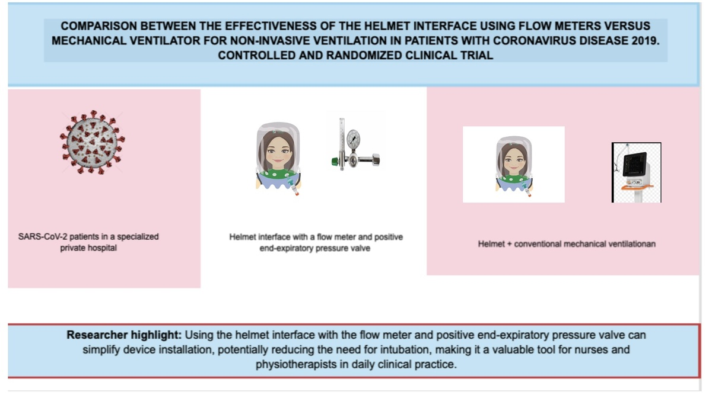

Comparison of the effectiveness of the helmet interface using flow meters versus the mechanical ventilator for non-invasive ventilation in patients with coronavirus disease 2019. Controlled and randomized clinical trial
DOI: 10.5114/aoms/183947
Arch Med Sci 2024;20(5):1538-1546
Notes:
Introduction
This study aimed to compare the effectiveness of two methods for non-invasive mechanical ventilation in patients with severe acute respiratory syndrome coronavirus 2 (SARS-CoV-2) – using a helmet interface with a flow meter and positive end-expiratory pressure valve versus a traditional mechanical ventilator.
Material and methods
We conducted a single-center randomized clinical trial involving 100 adult SARS-CoV-2 patients in a specialized private hospital. Participants were randomly assigned to two groups: one using the helmet interface with a flow meter and positive end-expiratory pressure valve and the other employing conventional mechanical ventilation. Our study included participant selection, blood gas analysis, assessment of respiratory rate, peripheral oxygen saturation, modified Borg scale scores, and a visual analog scale.
Results
The study showed no significant difference in intubation rates between the mechanical ventilation (54.3%) and helmet interface with flow meter and positive end-expiratory pressure valve (46.8%) groups (p = 0.37). Additionally, the helmet group had a shorter average duration of use (3.4 ±1.6 days) compared to the mechanical ventilation group (4.0 ±1.9 days). The helmet group also had a shorter average hospitalization duration (15.9 ±7.9 days) compared to the mechanical ventilation group (17.1 ±9.5 days).
Conclusions
This single-center randomized clinical trial found no statistically significant differences between the two methods of non-invasive ventilation. Implications for clinical practice: using the helmet interface with the flow meter and positive end-expiratory pressure valve can simplify device installation, potentially reducing the need for intubation, making it a valuable tool for nurses and physiotherapists in daily clinical practice.

