Slide 1
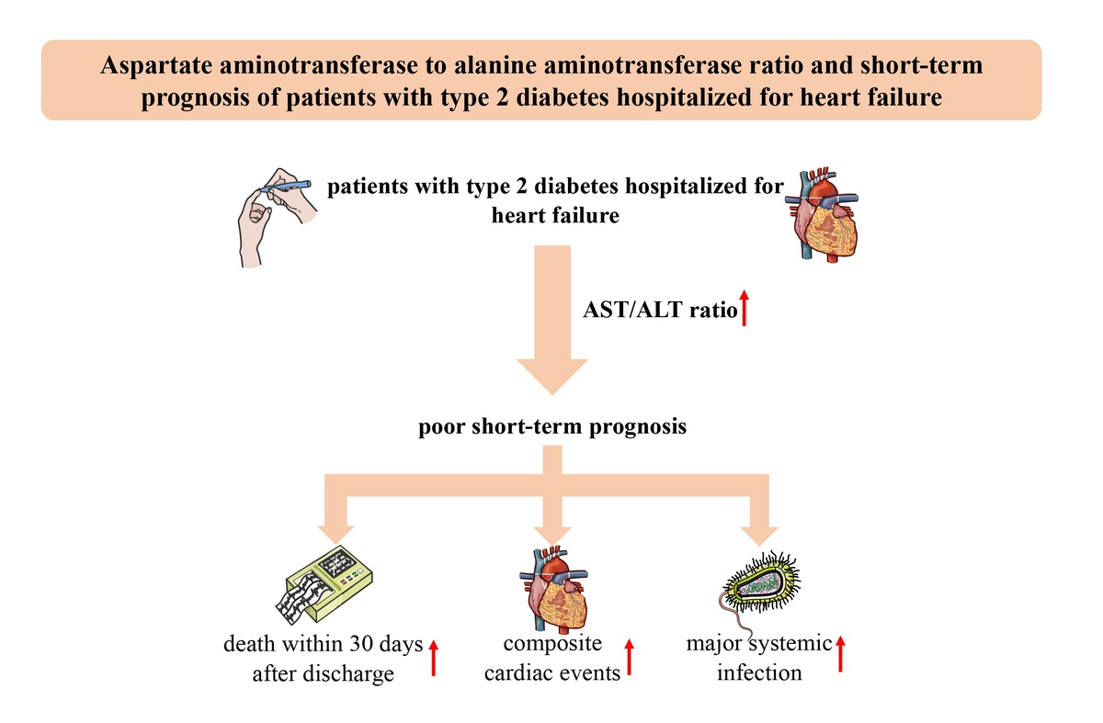

Aspartate aminotransferase to alanine aminotransferase ratio and short-term prognosis of patients with type 2 diabetes hospitalized for heart failure
DOI: 10.5114/aoms/184153
Arch Med Sci 2024;20(5):1416-1425
Notes:
Introduction
We aimed to explore the prognostic value of the aspartate aminotransferase to alanine aminotransferase (AST/ALT) ratio in non-surgical patients with type 2 diabetes hospitalized for heart failure.
Material and methods
Using a large electronic medical record-based cohort of diabetes in China (WECODe), we gathered data on non-surgical hospitalized patients with type 2 diabetes and heart failure from 2011 to 2019. Baseline AST/ALT ratio was calculated. The primary outcomes were all-cause death within 30 days after discharge, composite cardiac events, major acute kidney injury, and major systemic infection. A multivariable Cox proportional regression model was utilized to evaluate the association between the AST/ALT ratio and outcomes.
Results
This retrospective cohort included 8,073 patients (39.4% women) with type 2 diabetes hospitalized for heart failure. The median age was 71 years. Higher AST/ALT ratio was associated with higher risks of poor endpoints (with per standard deviation increment in AST/ALT ratio, for death within 30 days after discharge: adjusted hazard ratio [HR], 1.35, 95% confidence interval [CI], 1.21 to 1.50; for composite cardiac events: HR, 1.18, 95% CI: 1.06 to 1.31). Compared to patients in the lowest quartile for the AST/ALT ratio, those in the highest quartile have elevated risk of death within 30 days after discharge and major systemic infection (HRs [95% CIs]: 1.61 [1.18 to 2.19] and 1.28 [1.06 to 1.56], respectively). Subgroup analyses and sensitivity analyses confirmed the robustness of the findings.
Conclusions
Type 2 diabetes patients hospitalized for heart failure with the AST/ALT ratio in the highest quartile face a poor short-term prognosis.

