Slide 1
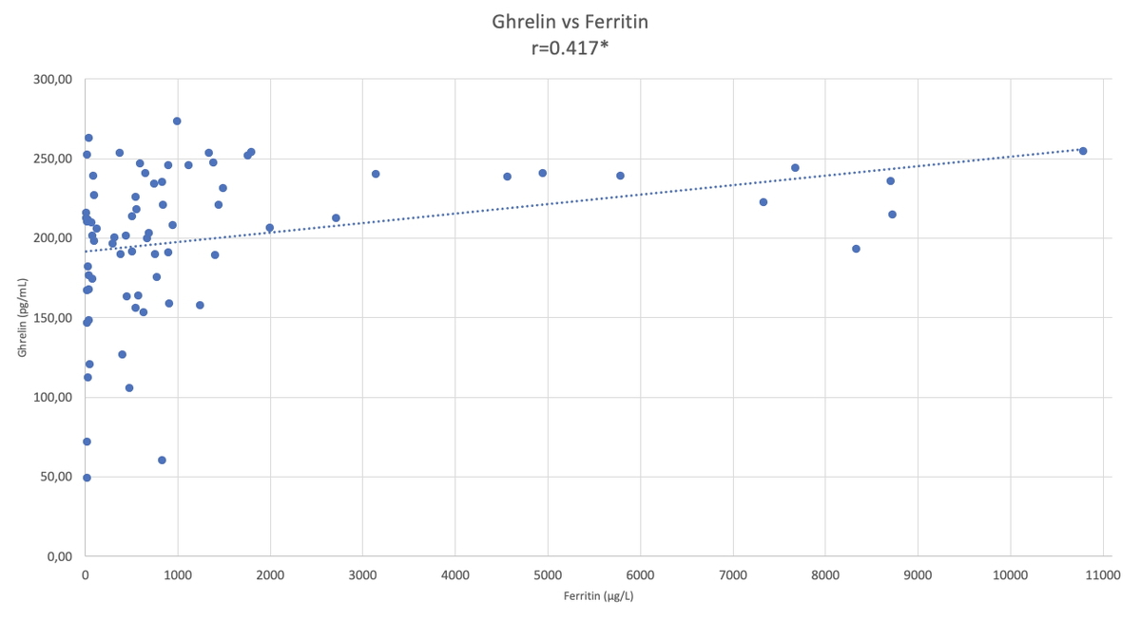

The relationship between ghrelin and iron metabolism in beta thalassaemia major patients
DOI: 10.5114/aoms/184702
Arch Med Sci 2025;21(4):1354-1360
Notes:
Introduction
Studies in beta thalassaemia major (β-TM) patients have shown that the responses of HIF2α, hepcidin, and ferroportin molecules to high iron levels are impaired. In recent years, studies conducted in patients with iron deficiency anaemia have investigated the relationship between ghrelin hormone and iron metabolism. In this study, we aimed to contribute to the aetiopathogenesis of this disease by examining the changes in ghrelin hormone levels in patients with β-TM.
Material and methods
Fifty-two β-TM and 23 controls were included in our study. Blood counts, routine biochemical parameters, HIF2α, hepcidin, and ghrelin levels were studied in blood samples taken from the volunteers.
Results
Erythrocyte indexes, serum bilirubin, iron, unsaturated iron binding capacity, total iron binding capacity, and ferritin levels showed significant differences between the 2 groups (p < 0.05). There was no significant difference between 2 groups for serum HIF2α and hepcidin levels. When the 2 groups were compared, ghrelin levels were found to be significantly higher in the patients (p < 0.05). When the correlation between parameters was examined in all subjects, a weak positive correlation was found between ghrelin and HIF2α (r = 0.263) (p < 0.05), and a significant positive correlation was found between ghrelin and ferritin (r = 0.417) (p < 0.05).
Conclusions
Our study showed that there is a positive correlation between ghrelin and ferritin levels. Elevated ghrelin levels in patients with β-TM may play an important role in regulating impaired iron metabolism. Molecular level studies are needed to determine synthesis pathways.

