Slide 1
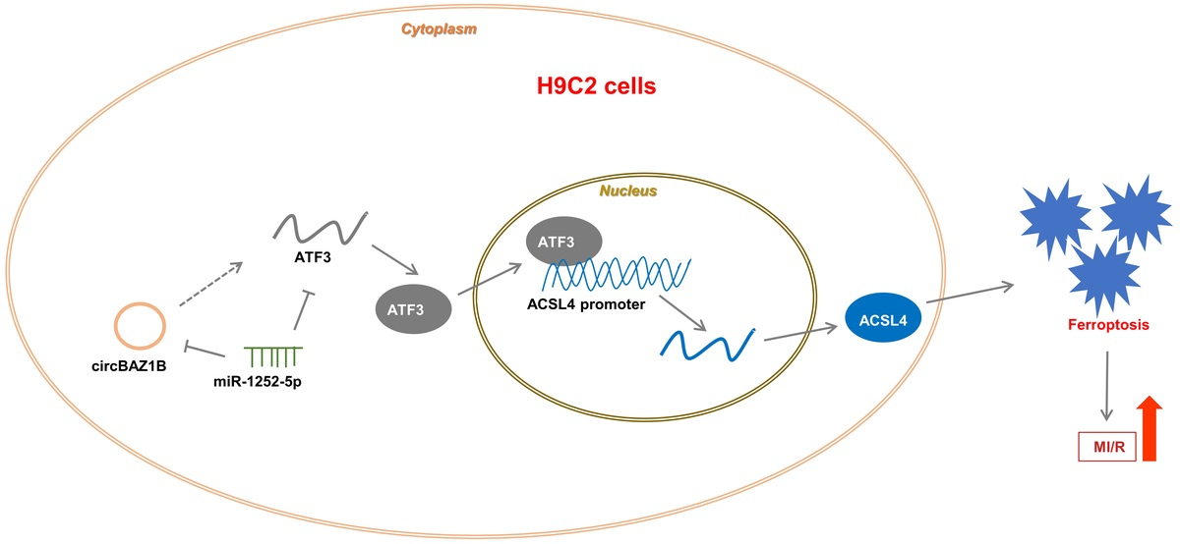

CircBAZ1B stimulates myocardial ischemia/reperfusion injury (MI/RI) by modulating miR-1252-5p/ATF3-mediated ferroptosis
DOI: 10.5114/aoms/185257
Arch Med Sci 2024;20(6):1968-1984
Notes:
Introduction
Circular RNAs (circRNAs) have been implicated in myocardial ischemia (MI)/reperfusion injury (RI), yet their essential roles in MI/RI-induced ferroptosis have not been fully elucidated. Here, we focused on the biological function and regulatory mechanism of circBAZ1B, a circRNA derived from the bromodomain adjacent to the zinc finger domain 1B (BAZ1B) gene, in MI/RI progression.
Material and methods
We used a rat model for MI/RI, assessing myocardial infarct size via electrocardiogram (ECG) and histological staining (hematoxylin and eosin [H&E] and 2,3,5-triphenyltetrazolium chloride [TTC]). Rat cardiomyoblasts (H9c2) were used for in vitro hypoxia-reoxygenation (H/R) cell model construction. Cell viability, apoptosis, lipid reactive oxygen species (ROS) levels and iron content were determined via Cell Counting Kit-8 (CCK-8) and flow cytometric assays. Gene and ferroptosis-related protein expression levels were verified by qRT‒PCR and Western blotting. RNA pull-down, RNA immunoprecipitation (RIP), and a dual-luciferase reporter system were utilized for verification of the molecular interactions.
Results
The results showed that MI/RI was accompanied by ferroptosis. We also found that activating transcription factor 3 (ATF3) knockdown promoted myocardial cell viability and inhibited ferroptosis. Notably, activation of ATF3 transcription was demonstrated to upregulate the expression of its downstream target ACSL4. Functional analysis indicated that circBAZ1B promoted ATF3 expression via miR-1252-5p. In vivo experimental data further revealed that circBAZ1B suppressed cardiomyocyte activity and promoted ferroptosis, thereby facilitating MI/RI progression.
Conclusions
The circBAZ1B/miR-1252-5p/ATF3 axis is crucial in MI/RI pathogenesis through ferroptosis regulation, offering a potential therapeutic target. Inhibiting this pathway may alleviate MI/RI effects, suggesting the need for further clinical studies.

