Slide 1
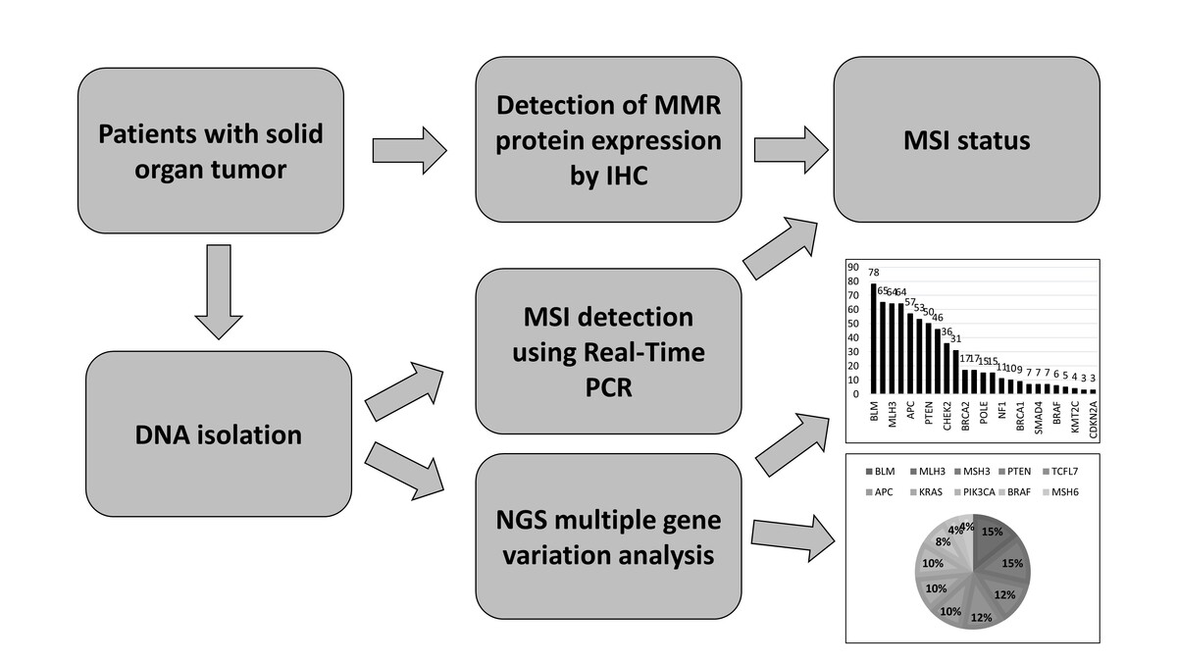

Microsatellite instability and somatic gene variant profile in solid organ tumors
DOI: 10.5114/aoms/185326
Arch Med Sci 2024;20(5):1672-1679
Notes:
Introduction
Absence of mismatch repair (MMR) genes in tumor cells or errors in the replication repair process may lead to DNA-MMR deficiency and microsatellite instability (MSI) formation. Specific tumor environments where gene variations are observed are believed to be conducive to the formation of MSI. This study aimed to determine the MSI status, MMR protein expression, and somatic mutation profile in solid organ tumors.
Material and methods
In this study, the records of 192 patients with solid organ tumors who were referred to the Molecular Pathology Laboratory between January 2018 and December 2022 were reviewed retrospectively. The MSI profiles of the patients were evaluated using real-time polymerase chain reaction (PCR) and immunohistochemical (IHC) methods. Somatic variations in the patients were detected using an NGS colon cancer panel.
Results
In the IHC evaluation, 22 cases showed MMR-deficient (dMMR) or high MSI (MSI-H), and 170 cases showed MMR-proficient (pMMR) or microsatellite stable (MSS). Real-time PCR results on the 22 dMMR cases revealed that 11 cases had MSI-H and 11 cases had MSS status. Among the 170 cases with pMMR, 160 cases were found to have MSS status, while 10 cases had low MSI (MSI-L). NGS analysis revealed that the three most frequent pathogenic variants in all cases were BLM exon 7 c.1544delA, MSH3 exon 7 c.1148delA, and MLH3 exon 2 c.1755delA. MSI-H cancer patients had a higher variation burden compared to MSS cancer patients. The most frequently observed pathogenic variant in both MSI-H and MSS cancer patients was BLM exon 7 c.1544delA.
Conclusions
Our study covers not only colorectal cancer patients but also other solid tumor types, providing the first data from the Turkish population on the MSI-H/dMMR status and somatic mutation profile in the presence of this condition.

