Slide 1
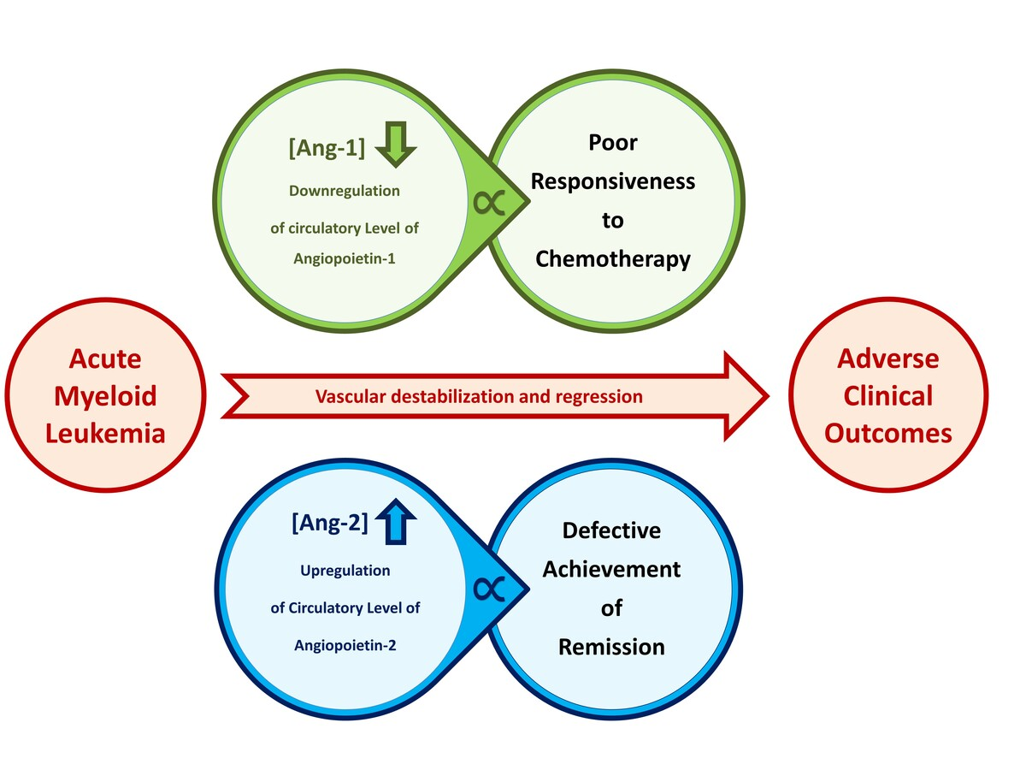

Prognostic value of circulatory growth factors to predict responsiveness to chemotherapy and remission status of patients with acute myeloid leukemia
DOI: 10.5114/aoms/185617
Arch Med Sci 2024;20(6):1887-1893
Notes:
Introduction
Tumor neovascularization, an essential requirement for malignant disease progression and metastasis, depends on the dysregulation of pro-angiogenic and anti-angiogenic activities. This study aimed to investigate the utilization of circulatory angiopoietins (Ang-1 and Ang-2), vascular endothelial growth factor (VEGF-A and VEGF-C), and basic fibroblast growth factor (bFGF) as a prognostic tool for acute myeloid leukemia (AML).
Material and methods
Twenty-four AML patients who were under chemotherapeutic intervention were included. Patients’ relapse status, responsiveness to chemotherapy, and remission status were obtained from their medical profiles. For comparative purposes, fifteen healthy subjects were included. Serum levels of growth factors were measured.
Results
As compared to control subjects, AML patients had significantly lower average levels of Ang-1 (170.8 ±12.7 versus 59.2 ±12.5 ng/ml) and VEGF-A (56.0 ±13.1 versus 98.6 ±11.9 ng/dl) that coincide with a higher average level of Ang-2 (18.5 ±4.1 ng/ml versus 7.5 ±0.8 ng/ml). Spearman’s correlation analysis defined a significant association of sAng-1 and sAng-2 with patients’ response to chemotherapy ( = 0.488) and remission status ( = 0.476), respectively. According to the receiver operating characteristic (ROC) curve, downregulation of Ang-1 has good predictivity for poor responsiveness to chemotherapy (AUC = 0.781, p < 0.05) while upregulation of sAng-2 has good predictivity for failed remission status (AUC = 0.779, p < 0.05).
Conclusions
In the context of AML, dysregulated circulatory levels of Ang-1 and Ang-2 are suggested prognostic markers to provide useful predictivity of patients’ adverse responsiveness to chemotherapy and remission status, respectively.

