Slide 1
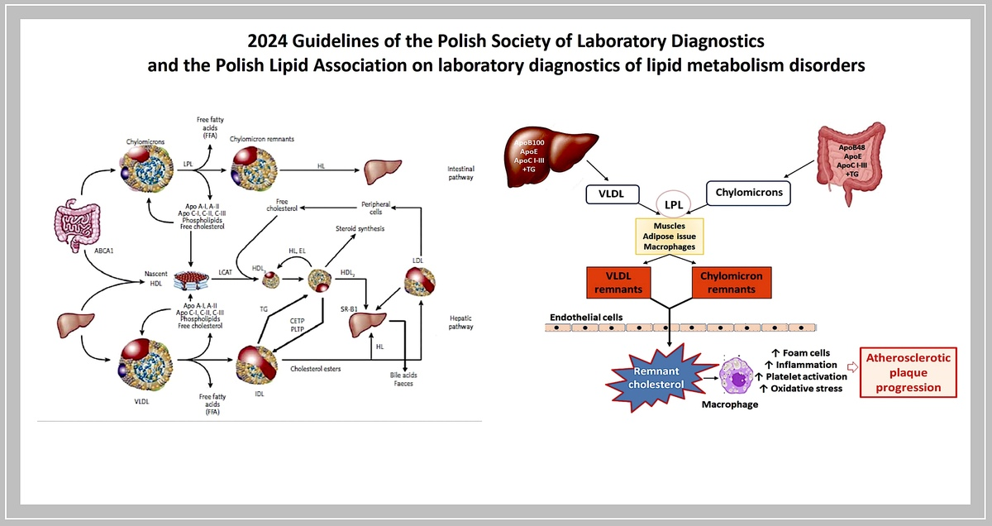

2024 Guidelines of the Polish Society of Laboratory Diagnostics and the Polish Lipid Association on laboratory diagnostics of lipid metabolism disorders
DOI: 10.5114/aoms/186191
Arch Med Sci 2024;20(2):357-374
Notes:
Lipid disorders are the most common (even 70%) and worst monitored cardiovascular risk factor (only 1/4 of patients in Poland and in CEE countries are on the low-density lipoprotein cholesterol (LDL-C) goal). To improve this, clear and simple diagnostic criteria should be introduced for all components of the lipid profile. These are the updated guidelines of the two main scientific societies in Poland in the area – the Polish Society of Laboratory Diagnostics (PSLD) and the Polish Lipid Association (PoLA), which, in comparison to those from 2020, introduce few important changes in recommendations (two main lipid targets, new recommendations on LDL-C measurements, calculations new goals for triglycerides, new recommendations on remnants and small dense LDL) that should help the practitioners to be early with the diagnosis of lipid disorders and in the effective monitoring (after therapy initiation), and in the consequence to avoid the first and recurrent cardiovascular events.

