Slide 1
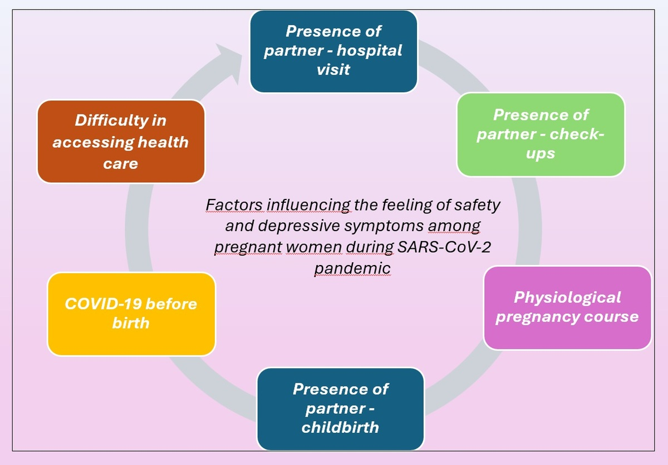

Factors affecting pregnant women’s feelings of safety and depressive symptoms during the SARS-CoV-2 pandemic
DOI: 10.5114/aoms/186356
Arch Med Sci 2024;20(2):679-681
Notes:
<b>Introduction</b>
<b>Material and methods</b>
<b>Results</b>
<b>Conclusions</b>
<b></b>
<b></b>

