Slide 1
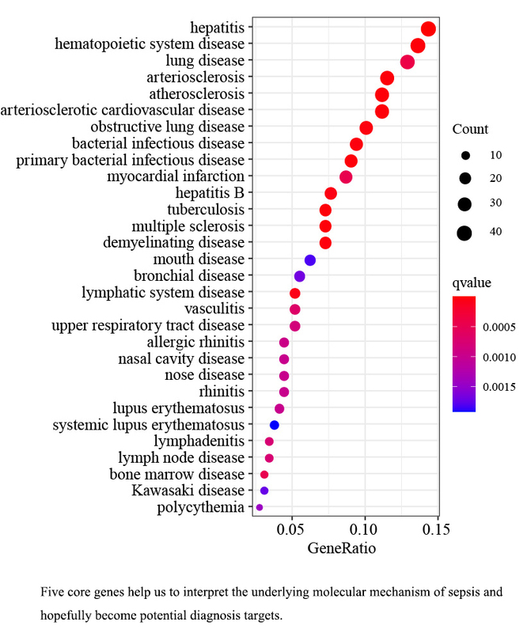

Identifying core genes in sepsis by LASSO regression and SVM-RFE algorithm
DOI: 10.5114/aoms/186506
Notes:
Introduction
Sepsis is a major disease in intensive care units (ICU), with high morbidity and mortality. However, the core genes associated with the sepsis diagnosis remain unclear.
Material and methods
By merging five datasets, gene expression profiles were obtained: GSE28750, GSE57065, GSE64457, GSE65682 and GSE95233. Differentially expressed genes (DEGs) were identified using the Limma package in R. To examine the enriched functions, both Kyoto Encyclopedia of Genes and Genomes (KEGG) and Gene Ontology (GO) were employed. Subsequently, the protein-protein interaction network (PPI) was constructed, and module analysis was carried out using STRING and Cytoscape. Furthermore, core genes were identified using support vector machine recursive feature elimination (SVM-RFE) analysis and the least absolute shrinkage and selection operator (LASSO) model. To verify the diagnostic significance of these essential genes, we conducted an analysis of the receiver operating characteristic curve (ROC).
Results
We analyzed 230 DEGs, consisting of 183 upregulated DEGs and 47 downregulated DEGs. The GO and KEGG analyses revealed that the DEGs were enriched in immune-related pathways and functions. The DEGs formed a PPI network consisting of 180 protein nodes and 351 interaction edges. Ultimately, we identified the five critical core genes (C3AR1, CHPT1, RAB32, SLC22A4, and SRPK1) common between both algorithms. The analysis of the ROC curve demonstrated that the AUC values for the five fundamental genes were as follows: 0.881, 0.876, 0.946, 0.927, and 0.931, respectively.
Conclusions
The five core genes screened in this study will help us to interpret the underlying molecular mechanism of sepsis and hopefully become potential diagnostic targets.

