Slide 1
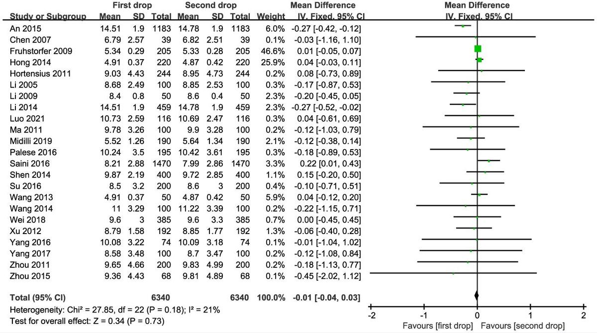

First versus second drop of capillary blood for monitoring blood glucose: a meta-analysis and systematic review
DOI: 10.5114/aoms/186657
Arch Med Sci 2024;20(6):1909-1917
Notes:
Introduction
The accuracy of the first or second drop of capillary blood for blood glucose monitoring remains unclear. This meta-analysis aimed to compare and evaluate the accuracy of the first or second drop of capillary blood for blood glucose monitoring, to provide evidence for clinical blood glucose monitoring and nursing care.
Material and methods
Two authors searched PubMed, ClinicalTrials, Cochrane Library, Clinical Evidence, EMBASE, China National Knowledge Infrastructure (CNKI), Wanfang and Weipu databases for relevant literature about the comparison of blood glucose values of the first capillary blood from the establishment of each database until November 10, 2023. After screening, extracting data and evaluating the quality of the literature, RevMan 5.4 software was used for meta-analysis.
Results
Twenty-three studies involving a total of 3121 patients were finally included in this meta-analysis. There was no significant difference in the measured value of blood glucose between the first drop and the second drop of capillary blood (MD = –0.01, 95% CI (–0.04, 0.03), p = 0.73). There was no publication bias in the synthesized outcome tested by Begg’s regression analysis (p = 0.152). The result of subgroup analysis showed that there was no difference in the blood glucose values of the first two drops of blood measured by different blood glucose meters and different cleaning methods (all p > 0.05).
Conclusions
Current evidence suggests that when using capillary blood to monitor blood glucose, the first drop of capillary blood can be directly used to measure blood glucose.

