Slide 1
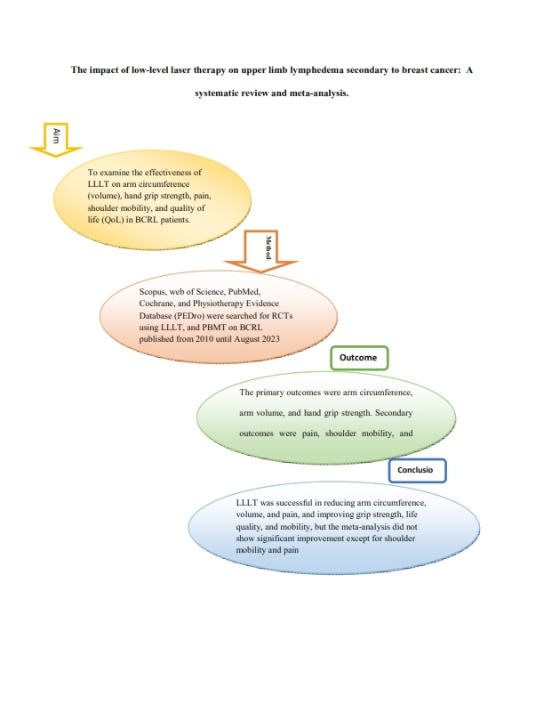

Impact of low-level laser therapy on upper limb lymphoedema secondary to breast cancer: a systematic review and meta-analysis
DOI: 10.5114/aoms/186874
Arch Med Sci 2025;21(3):889-896
Notes:
Introduction
This review analysed the efficiency of low-level laser therapy in treating breast cancer-related lymphedema (BCRL) in women.
Material and methods
Databases such as Scopus, PEDro, PubMed, Cochrane, and Web of Science were searched for RCTs using low-level laser therapy (LLLT) or photo-bio modulation therapy (PBMT) on BCRL published between 2010 and August 2023. Primary outcomes were arm circumference, volume, and hand grip strength, while secondary outcomes were pain, shoulder mobility, and quality of life.
Results
Eleven RCTs with a total of 379 patients were analysed, and 8 studies were included for meta-analysis. We found no significant difference between laser-treated and control groups in any of the trials in terms of arm circumference, arm volume, grip strength, and quality of life post-intervention, and a significant difference between the groups in terms of pain intensity and shoulder mobility.
Conclusions
This review revealed that low-level laser therapy (photobiostimulation) was successful in reducing arm circumference, volume, and pain, as well as enhancing grip strength, life quality, and mobility. However, the meta-analysis did not show any improvement except in pain and shoulder mobility. Further trials are required to assess the long- and short-term efficacy of LLLT in managing lymphoedema secondary to breast cancer.

