Slide 1
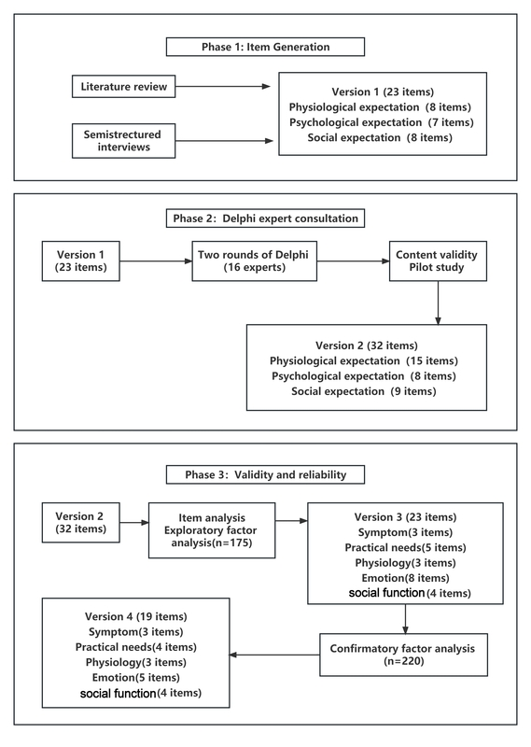

Development and validation of the treatment expectation scale for patients with liver cancer
DOI: 10.5114/aoms/186875
Arch Med Sci 2024;20(6):1831-1840
Notes:
Introduction
Liver cancer is one of the most common tumors in the world. Patients with liver cancer usually face substantial physical, psychological, and social burdens, which has created a great demand and expectation to ease the burden in all aspects. This study aimed to develop and validate the Treatment Expectation Scale for patients with Liver Cancer (TES-LC).
Material and methods
The study was conducted in three phases. In the first stage, we used literature reviews and semi-structured interviews to generate the items to be included in the questionnaire TES-LC (version 1). In the second stage, two rounds of the Delphi expert consultation method were used to modify the first version to form TES-LC (version 2). In the third stage, projects were selected through project analysis and exploratory factor analysis to create TES-LC (version 3); then version 3 was tested for reliability and validity to generate version 4.
Results
The final version of the TES-LC contains 19 items in 5 dimensions: disease symptoms, practical needs, psychological state, emotional satisfaction, and social function. Five common factors were extracted through exploratory factor analysis, explaining 60.11% of the variance. In the validation factor analysis, the fitting effect of the five-factor model was satisfactory after modification. The TES-LC had good internal consistency, with a Cronbach’s  coefficient of 0.911 for the total scale.
Conclusions
The TES-LC developed in this study has good reliability and validity and can provide a standardized tool for measuring treatment expectancy in patients with liver cancer, which is of good clinical utility.

