Slide 1
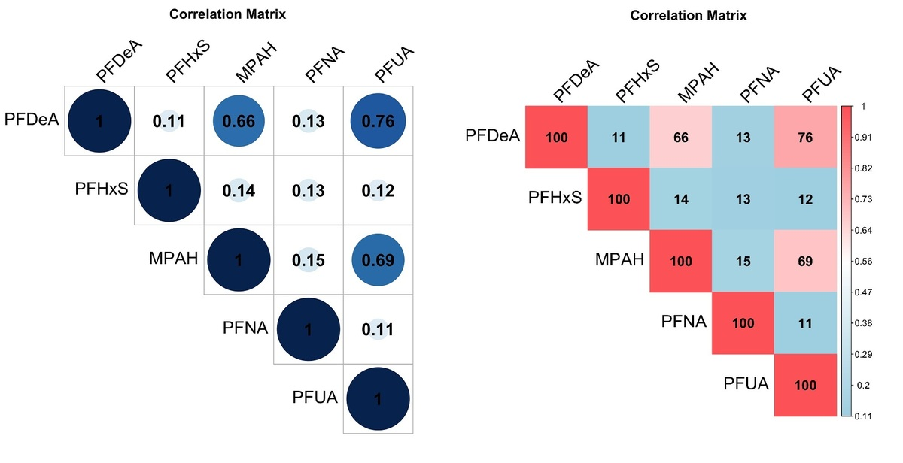

The association between mixed exposure to per- and polyfluoroalkyl substances and the risk of diabetes
DOI: 10.5114/aoms/187002
Arch Med Sci 2025;21(6):2319-2327
Notes:
Introduction
This study aimed to investigate the relationship between exposure to per- and polyfluoroalkyl substances (PFASs) and the risk of diabetes by analyzing a large dataset from the National Health and Nutrition Examination Survey (NHANES).
Material and methods
This study analyzed participants with complete data from the US NHANES database spanning from 2003 to 2018. Generalized linear regression models were used to examine the relationship between serum chemical concentrations and diabetes. Weighted quantiles and regression were employed to assess the association between mixed chemical exposure and diabetes. The ‘mixture effect’ between chemicals and diabetes was estimated using a quantile g-computation model.
Results
The study involved a total of 11,780 participants, with 1,451 individuals having diabetes and 10,329 not having diabetes. Logistic regression analysis was utilized to investigate the relationship between five PFAS chemicals and the risk of diabetes, while controlling for all covariates. The results indicated that none of the PFAS chemicals exhibited a statistically significant association with an increased risk of diabetes. However, when exploring the positive and negative constraint models of the weighted quantile sum (WQS), the coefficient of the chemical mixing index displayed a strong correlation with diabetes in model III, even after adjusting for covariates. Additionally, an evaluation of the ‘mixture effect’ using quantile g-computation revealed that among the five chemicals, the combined exposure effect of perfluorononanoate (PFNA) on diabetes was positive, whereas exposure to the other four chemicals had a negative impact.
Conclusions
The study findings suggest a possible association between PFASs and increased risk of diabetes, particularly highlighting PFNA’s positive correlation with the combined exposure effect on diabetes.

