Slide 1
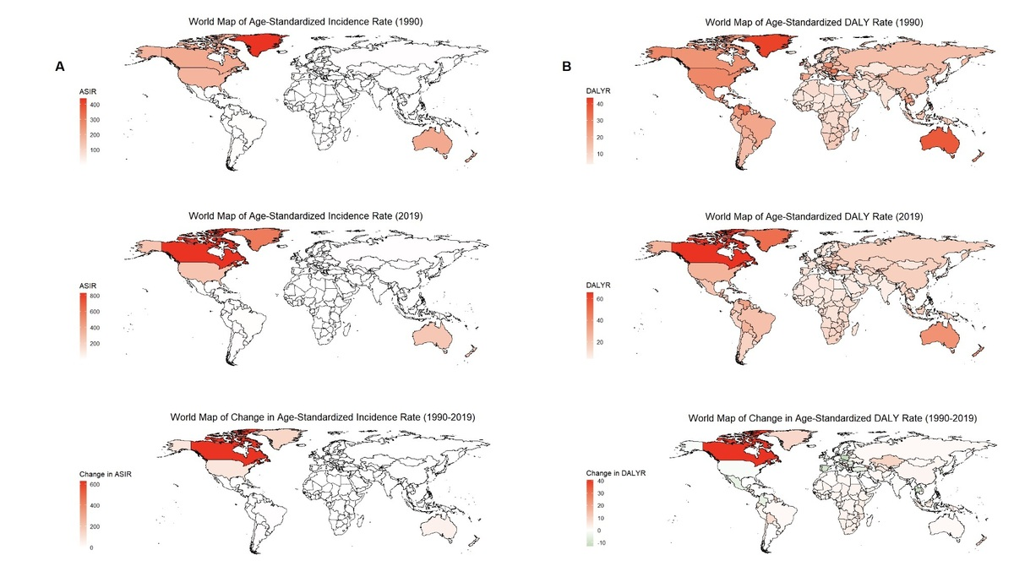

A study on the global burden of non-melanoma skin cancer from 1990 to 2019
DOI: 10.5114/aoms/187003
Arch Med Sci 2024;20(6):1902-1908
Notes:
Introduction
This study aimed to provide an overview and analysis of the global disease burden of non-melanoma skin cancer using data from the Global Burden of Disease 2019 (GBD 2019) database.
Material and methods
This study utilized the global GBD 2019 disease data. The data were categorized into various subgroups based on region, sociodemographic index (SDI), country, gender, and age. We analyzed incident cases, incidence rate, disability-adjusted life years (DALYs), DALY rate, as well as age-standardized indicators and their annualized percent change (EAPC).
Results
The global burden of non-melanoma skin cancer exhibited an increasing trend from 1990 to 2019. The EAPC for the age standardized incidence rate (ASIR) was 1.13, and the EAPC for the age standardized DALY rate was 0.20. Geographic variations were observed, with the most substantial increase in ASIR observed in high-income North America (EAPC = 2.20), and a significant increase in the age standardized DALY rate in Central Asia (EAPC = 2.32). Countries with a high SDI had the highest ASIR and showed the most significant increasing trend (EAPC = 1.97). Overall, the burden of disease for nonmelanoma skin cancer increased in all countries globally from 1990 to 2019. The EAPC for incident cases, DALYs, and ASIR was greater than 0 in almost all countries worldwide, indicating an overall increasing trend.
Conclusions
The global disease burden of non-melanoma skin cancer ex-hibited significant increasing changes from 1990 to 2019. Several countries in Asia, Africa, and North America experienced a severe disease burden.

