Slide 1
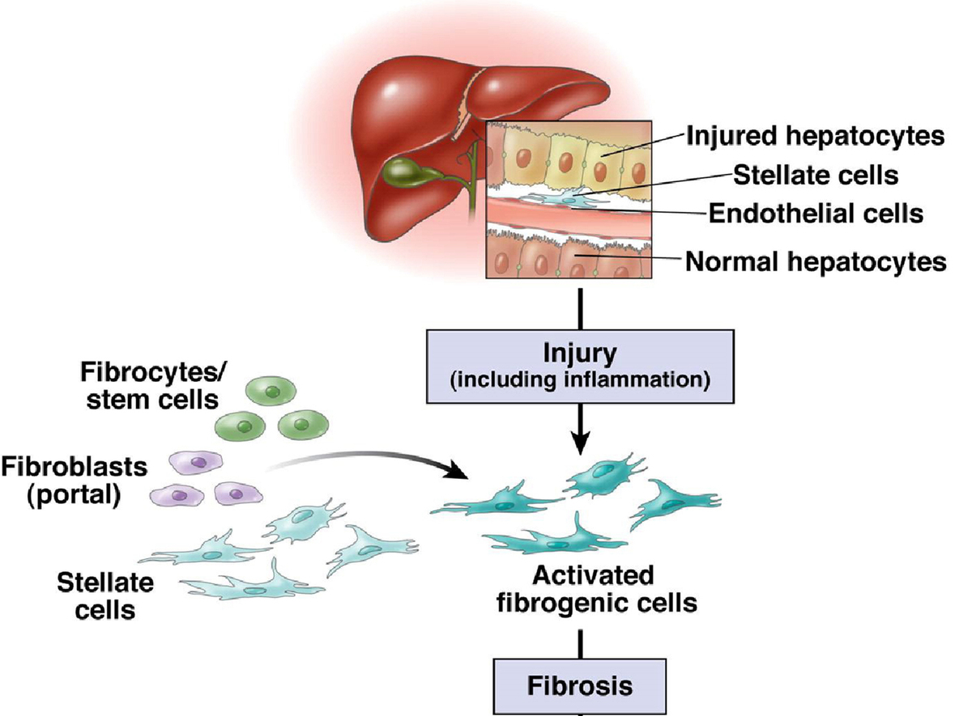

Progress and prospects of elastography techniques in the evaluation of fibrosis in chronic liver disease
DOI: 10.5114/aoms/187079
Arch Med Sci 2024;20(6):1784-1792
Notes:
The precise assessment of liver fibrosis degree is imperative for monitoring and managing chronic liver diseases. Traditionally, liver biopsy and quantitative blood biomarkers have been the mainstays for fibrosis assessment, albeit each with its inherent limitations. However, the emergence of elastography presents a promising non-invasive alternative, potentially supplanting or complementing traditional biomarkers. In contrast to conventional biomarkers, elastography offers several advantages. Firstly, it is non-invasive, sidestepping the risks and discomfort associated with liver biopsy. Secondly, this technique provides real-time and intuitive fibrosis assessments, characterized by user-friendly operation and high reproducibility. Thirdly, elastography excels in diagnosing moderate to severe fibrosis, is vital for determining treatment strategies and monitoring disease progression. Notably, MRE stands out as the most accurate non-invasive method for fibrosis assessment, especially suitable for advanced fibrotic stages. This article provides an overview of the advancements in elastography as a viable quantitative biomarker for chronic liver disease fibrosis burden.

